Slide 1
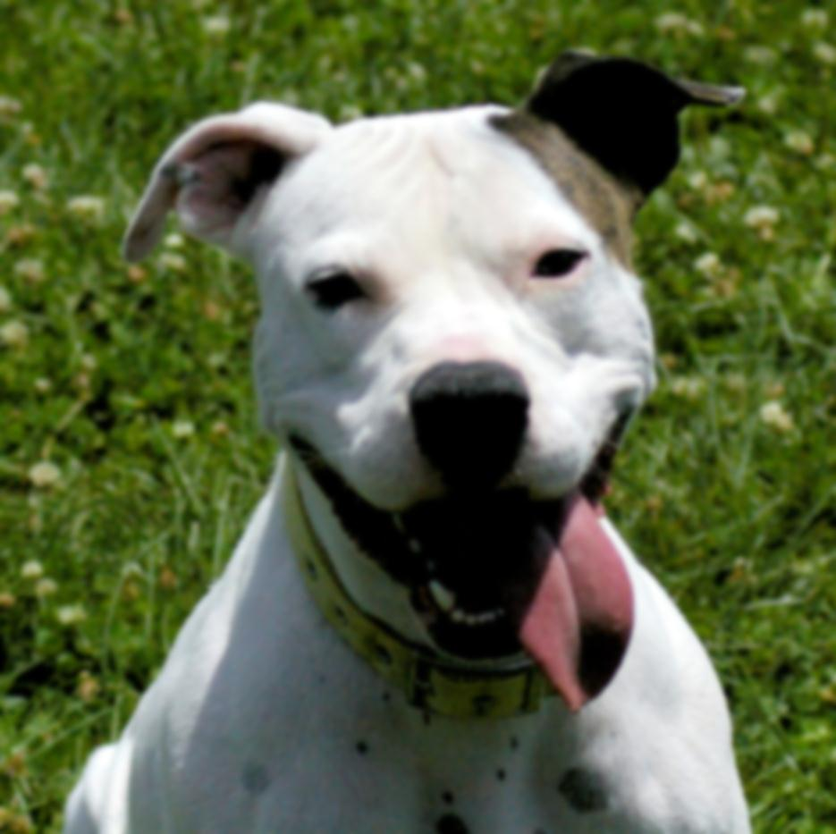

S.P.I.R.I.T.
Shelter Pups & Inmate Rehabilitation & Integration Training Program
Presented by
Constance Dwyer, CABC & Sara Hamburger, BMTA

Slide 2
Copyright Notice
WARNING
All rights reserved. No part of the course materials used in the instruction of this course may be reproduced in any form or by any
electronic or mechanical means, including the use
of information storage and retrieval systems,
without written approval from the copyright owner.
©2013-2018 Constance Dwyer
Training4k9s.com

Slide 3
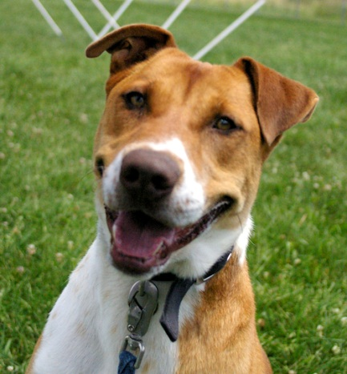
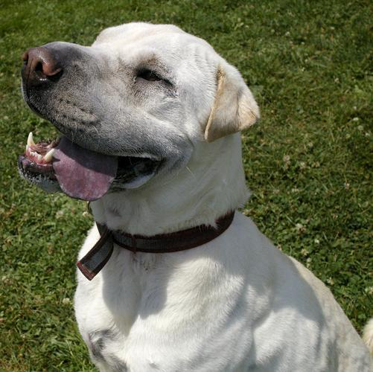
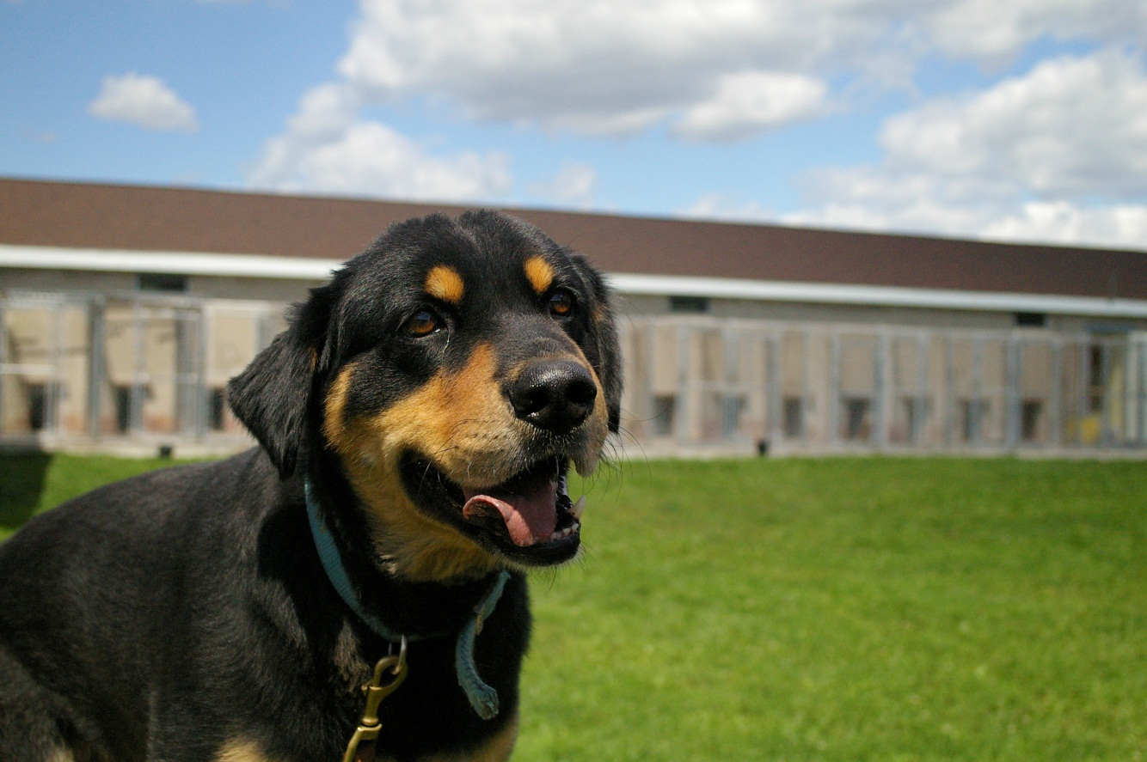
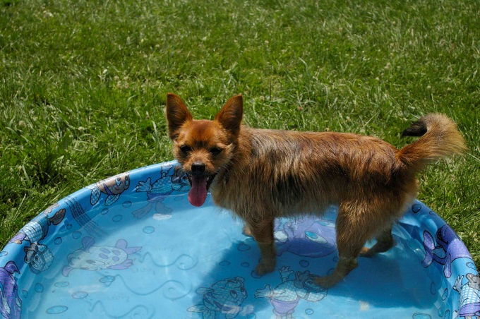
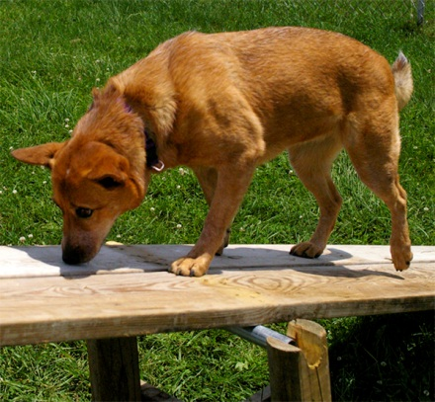
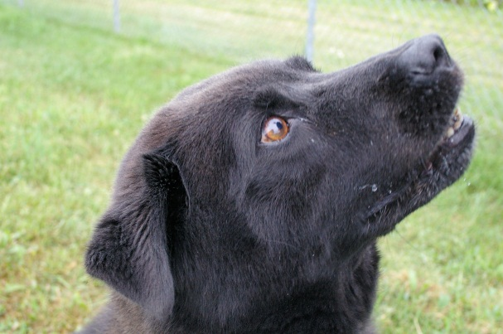
WELCOME!

Slide 4

Safety Message and Intros

Slide 5
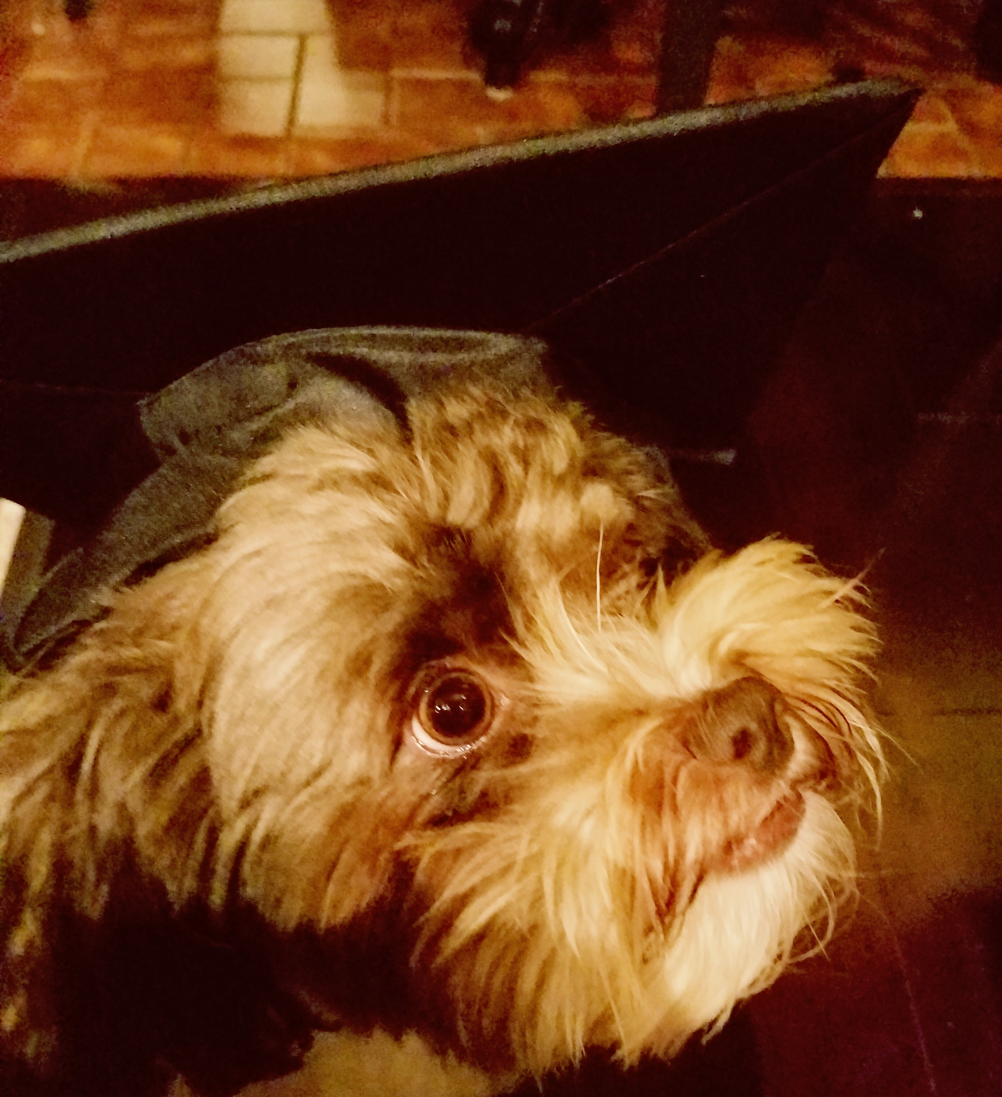
Learning Theory

Slide 6
Reinforcements
Positive
  involves the addition of a stimulus following a behavior that makes it more likely that the behavior will occur again in the future.
Negative
  involves strengthening a behavior through the removal of an aversive stimulus.
+R
-R

Slide 7
Reinforcements - examples
Positive
  Real life examples
    Treats
    Praise
    Play
    ???
Negative
  Real life examples
    Ear pinching
    Loose leash walking
    ???

Slide 8
Punishments
Positive
  involves the addition of an aversive stimulus following a behavior that makes it more likely that the behavior will decrease/weaken in the future.
Negative
  involves the removal of a desirable stimulus following a behavior that makes it more likely that the behavior will decrease/weaken in the future.
+P
-P

Slide 9
Punishments - examples
Positive
  Real life examples
    Yelling at the dog
    Collar “correction”
    Stepping on their toes
    Kneeing in the chest
    ???
Negative
  Real life examples
    Crate time out
    Turning your back
    Changing direction
    ???

Slide 10
Learning Quadrant Exercise
+R
Positive Reinforcement
-R
Negative Reinforcement
Decreases Behavior Increases Behavior
+P
Positive
Punishment
-P
Negative Punishment

Slide 11
Operant Conditioning
Type of learning in which an individual's behavior is modified by its consequences.
Operant conditioning is a term that was coined by B.F.Skinner. Operant conditioning is distinguished from classical conditioning in that operant conditioning deals with the modification of voluntary or operant behavior.

Slide 12
Classical Conditioning
Marker or Clicker Training
previously neutral stimulus (the click sound) is known as a Conditioned Stimulus that provokes a Conditioned Response (anticipation of food or something else the dog wants – toys, play).
Discovered by Psychologist Ivan Pavlov
– Pavlov’s Dogs

Slide 13
Why do we care?
As instructors and trainers we want to strengthen safe, positive associations to build trust, companionship and life long partnerships between humans and dogs.
Who are your friends and loved ones?
What relationships do you have with them?
What are they built on?

Slide 14
Hands On Learning
+R Behavior Shaping Game
  1person is a trainer
  1 person is a trainee
  No verbal directions
  Human behaviors
  Use clicker (marker) to communicate

Slide 15
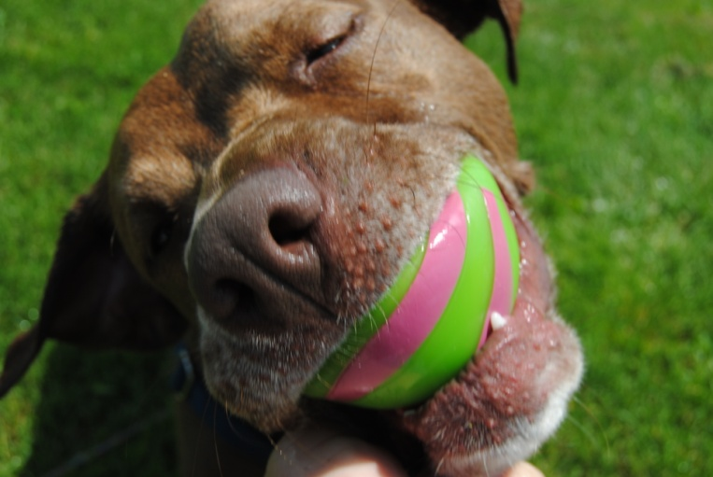
Enrichment

Slide 16
Importance of enrichment
Stress begins as soon as the animal is placed in the shelter and doesn’t completely end until the animal is adopted
Stress is a huge factor in the health of both animals and humans-How do you alleviate your stress? EX: Vacation, reading, relaxing, walking
Stressed animals are harder to adopt
Stressed animals show more aggression even if they were not aggressive when entering the shelter-
Stress results in placing an animal into a heightened survival mode and the Fight or Flight behaviors start to appear-
All living creatures have this instinct in them including humans.
If we didn’t have the fight of flight mode, we would die. Its that simple.
SIGNS OF STRESS SHOULD NOT BE IGNORED.. it affects both training and adoptability..

Slide 17
Causes of stress in shelters
Imagine this…you’ve spent the last 3 years, 8 years, 12 years, living with your family. Enjoying life. Happy. Then one day you go for a car ride and end up being forced into strangers hands, led into a 6’x10’ cage(if your lucky) where it is so deafening loud, cold, wet, and every dog around you acts like they want to kill you. Your confused. Scared. Shaking. And you wonder….how long will this last?

Slide 18
Stress in shelters (continued)
Scary environment
Separated from your family
Not sure how long you will be here
Loud
Damp
Barking dogs
People you don’t know
People you don’t know trying to touch you
Vet visit
Some days you don’t leave your run
No control over your environment

Slide 19
Signs of stress
Pacing
Spinning
Excessive jumping- In an attempt to control environment
Excessive barking- In an attempt to control environment
Panting-When not related to exercise or heat
Drooling-When not related to exercise or heat
Excessive drinking-
Increased aggression- In an attempt to control environment
Decreased activity-Depressed
Decreased appetite- Too stressed to eat when not due to illness
Shaking- When not due to illness or cold

Slide 20
Signs of stress (continued)
Animals exhibiting stress behaviors are most likely trying to control their environment because they feel confined and unable to do what is necessary for their needs and for their survival.

Slide 21
More enrichment ideas!
Give each animal something good when they return to their runs so returning doesn’t mean you leave and the fun is over. Make their runs a positive place to be.
Sit in’s-siting in with a dog or cat just spending time with them even if it’s only 5minutes can mean the difference between a good day and a bad day. A lot of the time we spend walking or training but we never spend time petting and/or just allowing the dog to sit next to you.
Think about your own pets, what do they get on a day to day basis that shelter dogs do not get? Your time and attention is one thing that most dogs living in shelter rarely experience enough of.

Slide 22
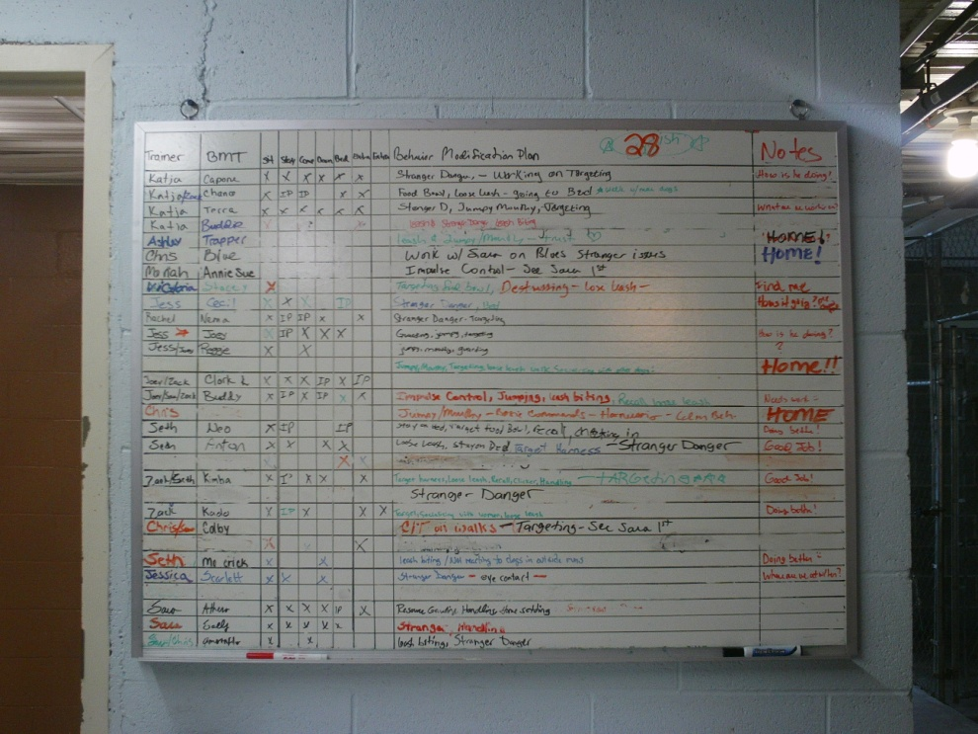
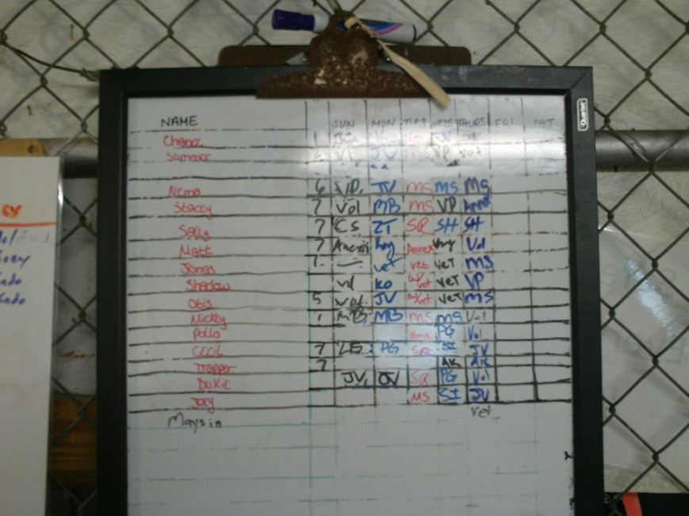
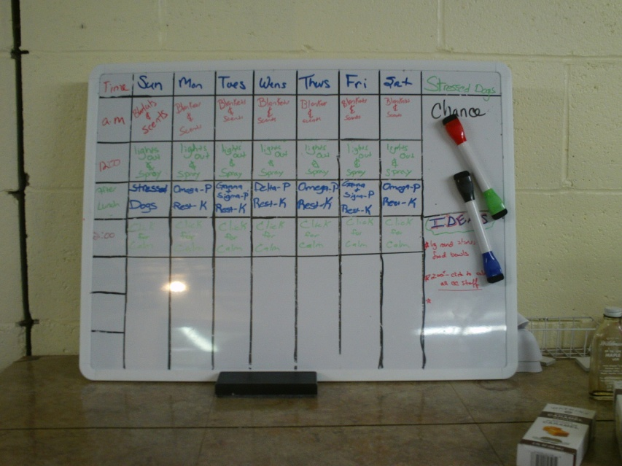
Enrichment schedules

Slide 23
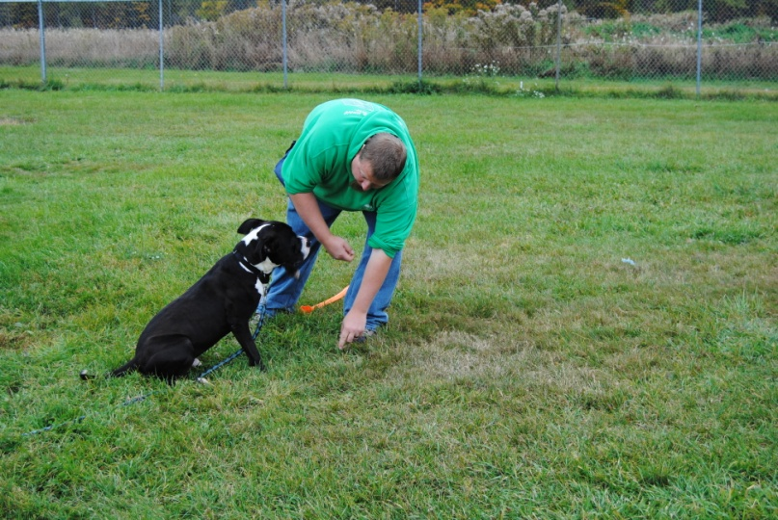
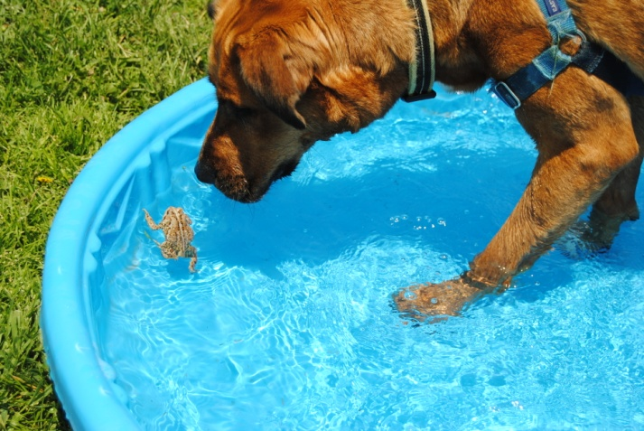
Enrichment rocks!

Slide 24
Questions?
Thank you for joining the SPIRIT team!

