Slide 1
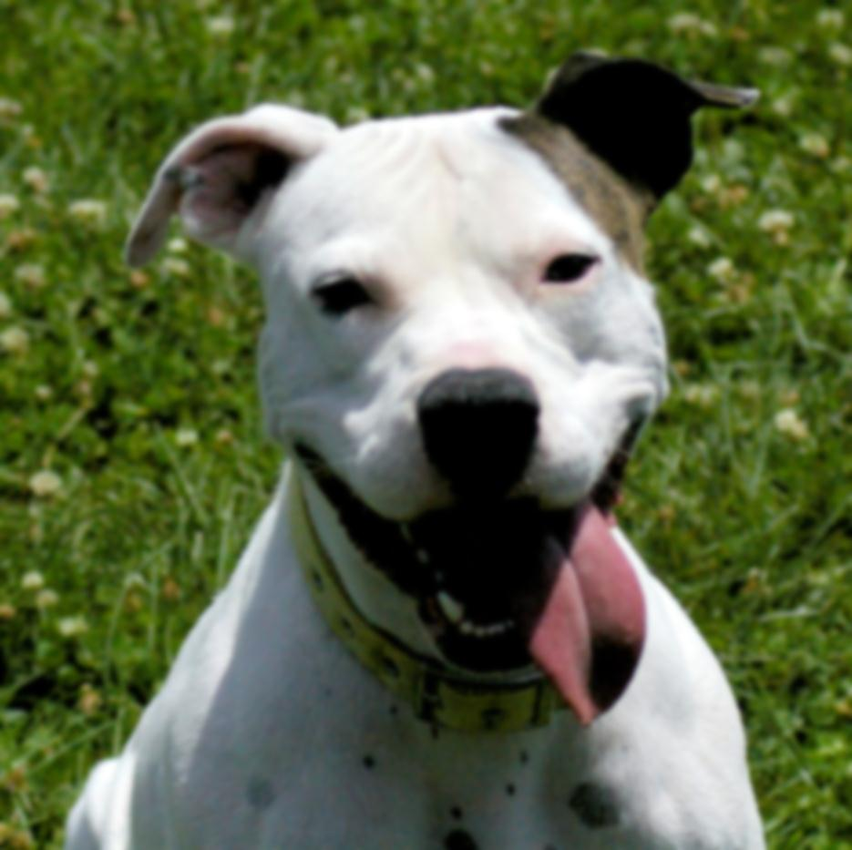

S.P.I.R.I.T.
Shelter Pups & Inmate Rehabilitation & Integration Training Program
Presented by
Constance Dwyer, CABC & Kathryn Boccia, ABCDT

Slide 2
Copyright Notice
WARNING
All rights reserved. No part of the course materials used in the instruction of this course may be reproduced in any form or by any
electronic or mechanical means, including the use
of information storage and retrieval systems,
without written approval from the copyright owner.
©2013-2017 Constance Dwyer
Training4k9s.com

Slide 3
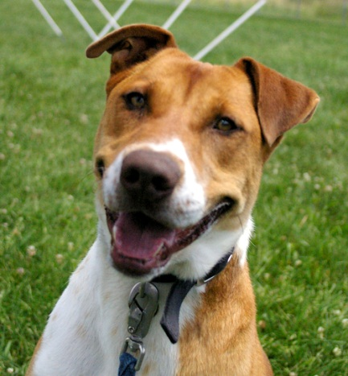
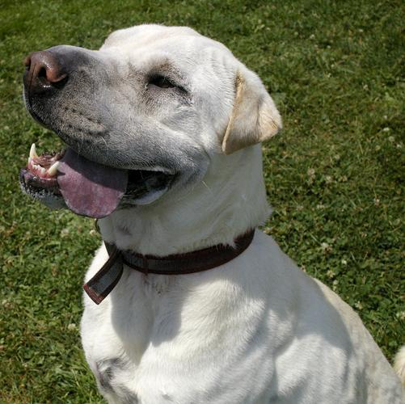
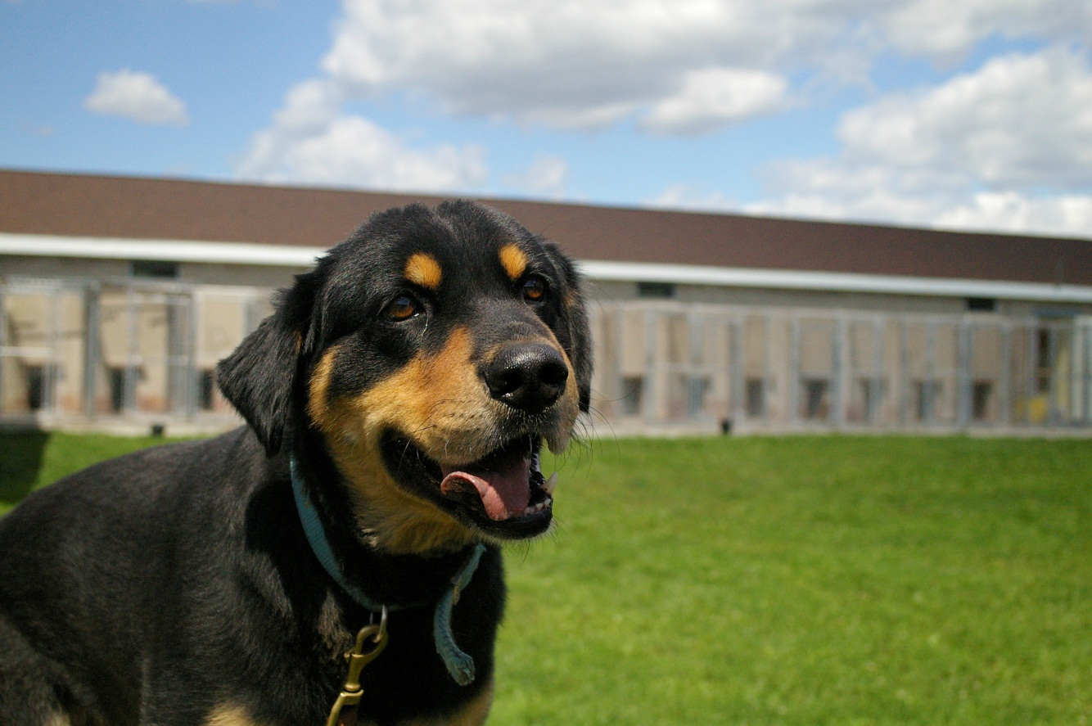
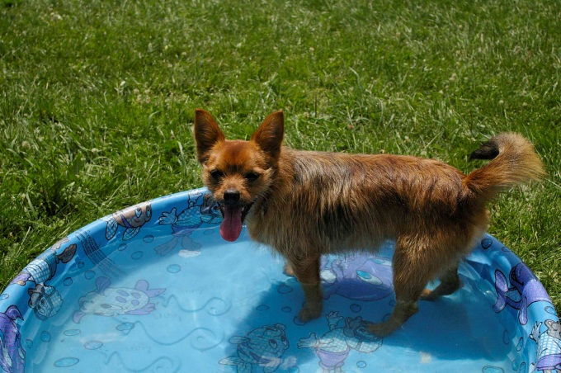
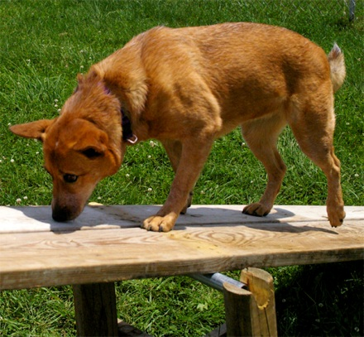
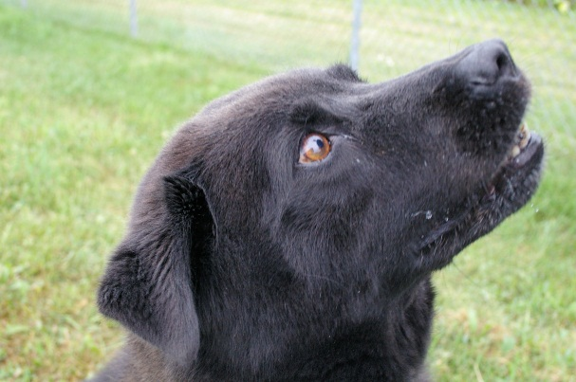
WELCOME!

Slide 4

Safety Message and Intros

Slide 5
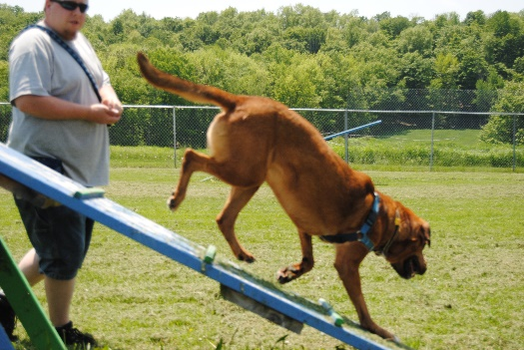
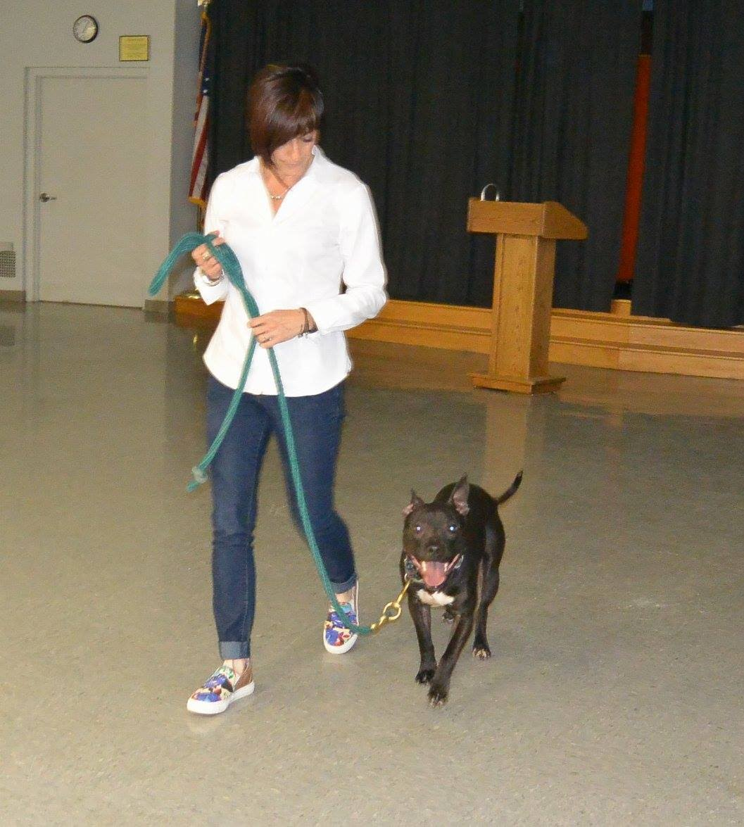
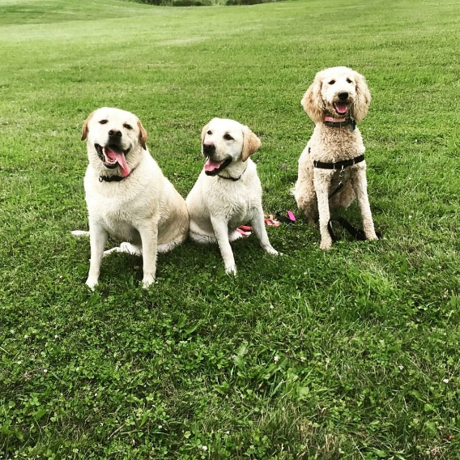
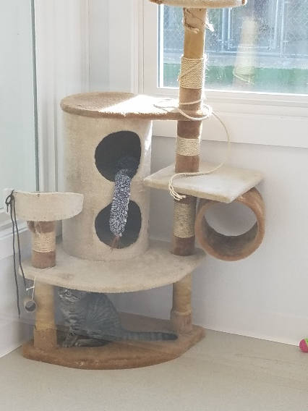
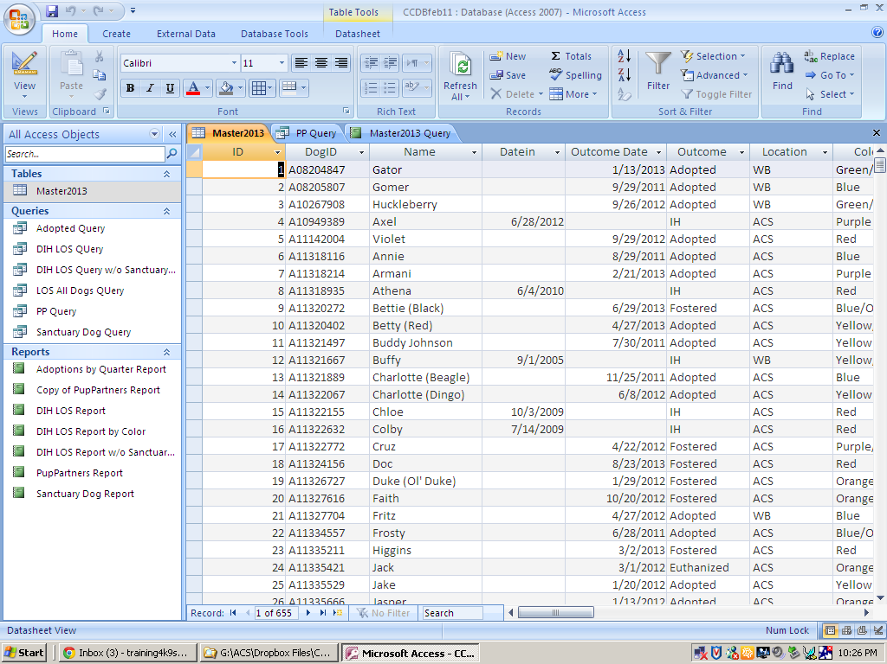
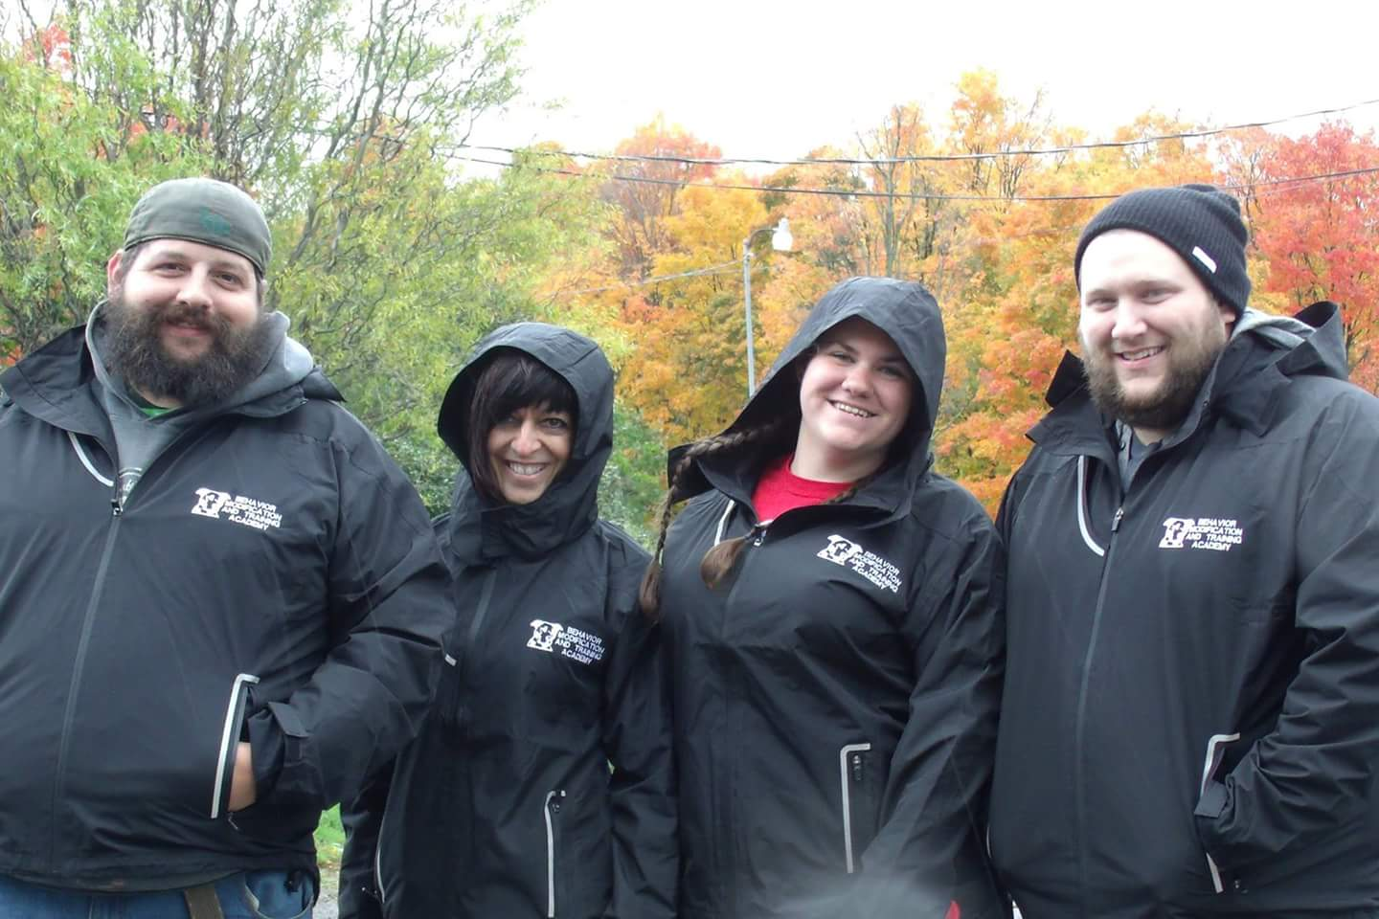
Behavior Assessments

Slide 6
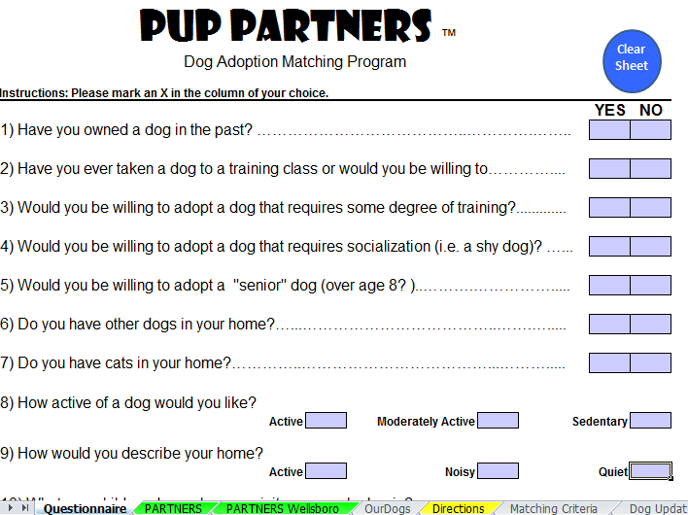
Adopter Questionnaire

Slide 7
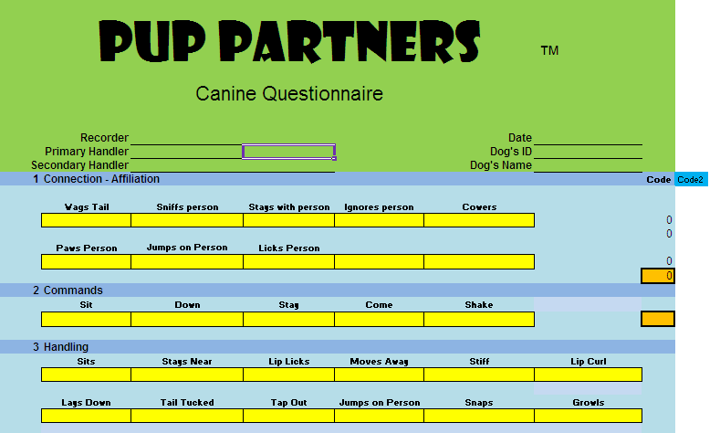
Dog Questionnaire

Slide 8
Dog Questionnaire Assessment
1) Affiliation
2)Commands
3) Handling
4) Playfulness
5) Resource Guarding
6) Reactiveness
7) Dog – Dog
8) Dog - Cat

Slide 9
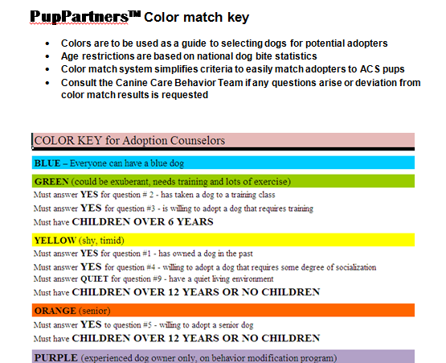
Color Matching System

Slide 10
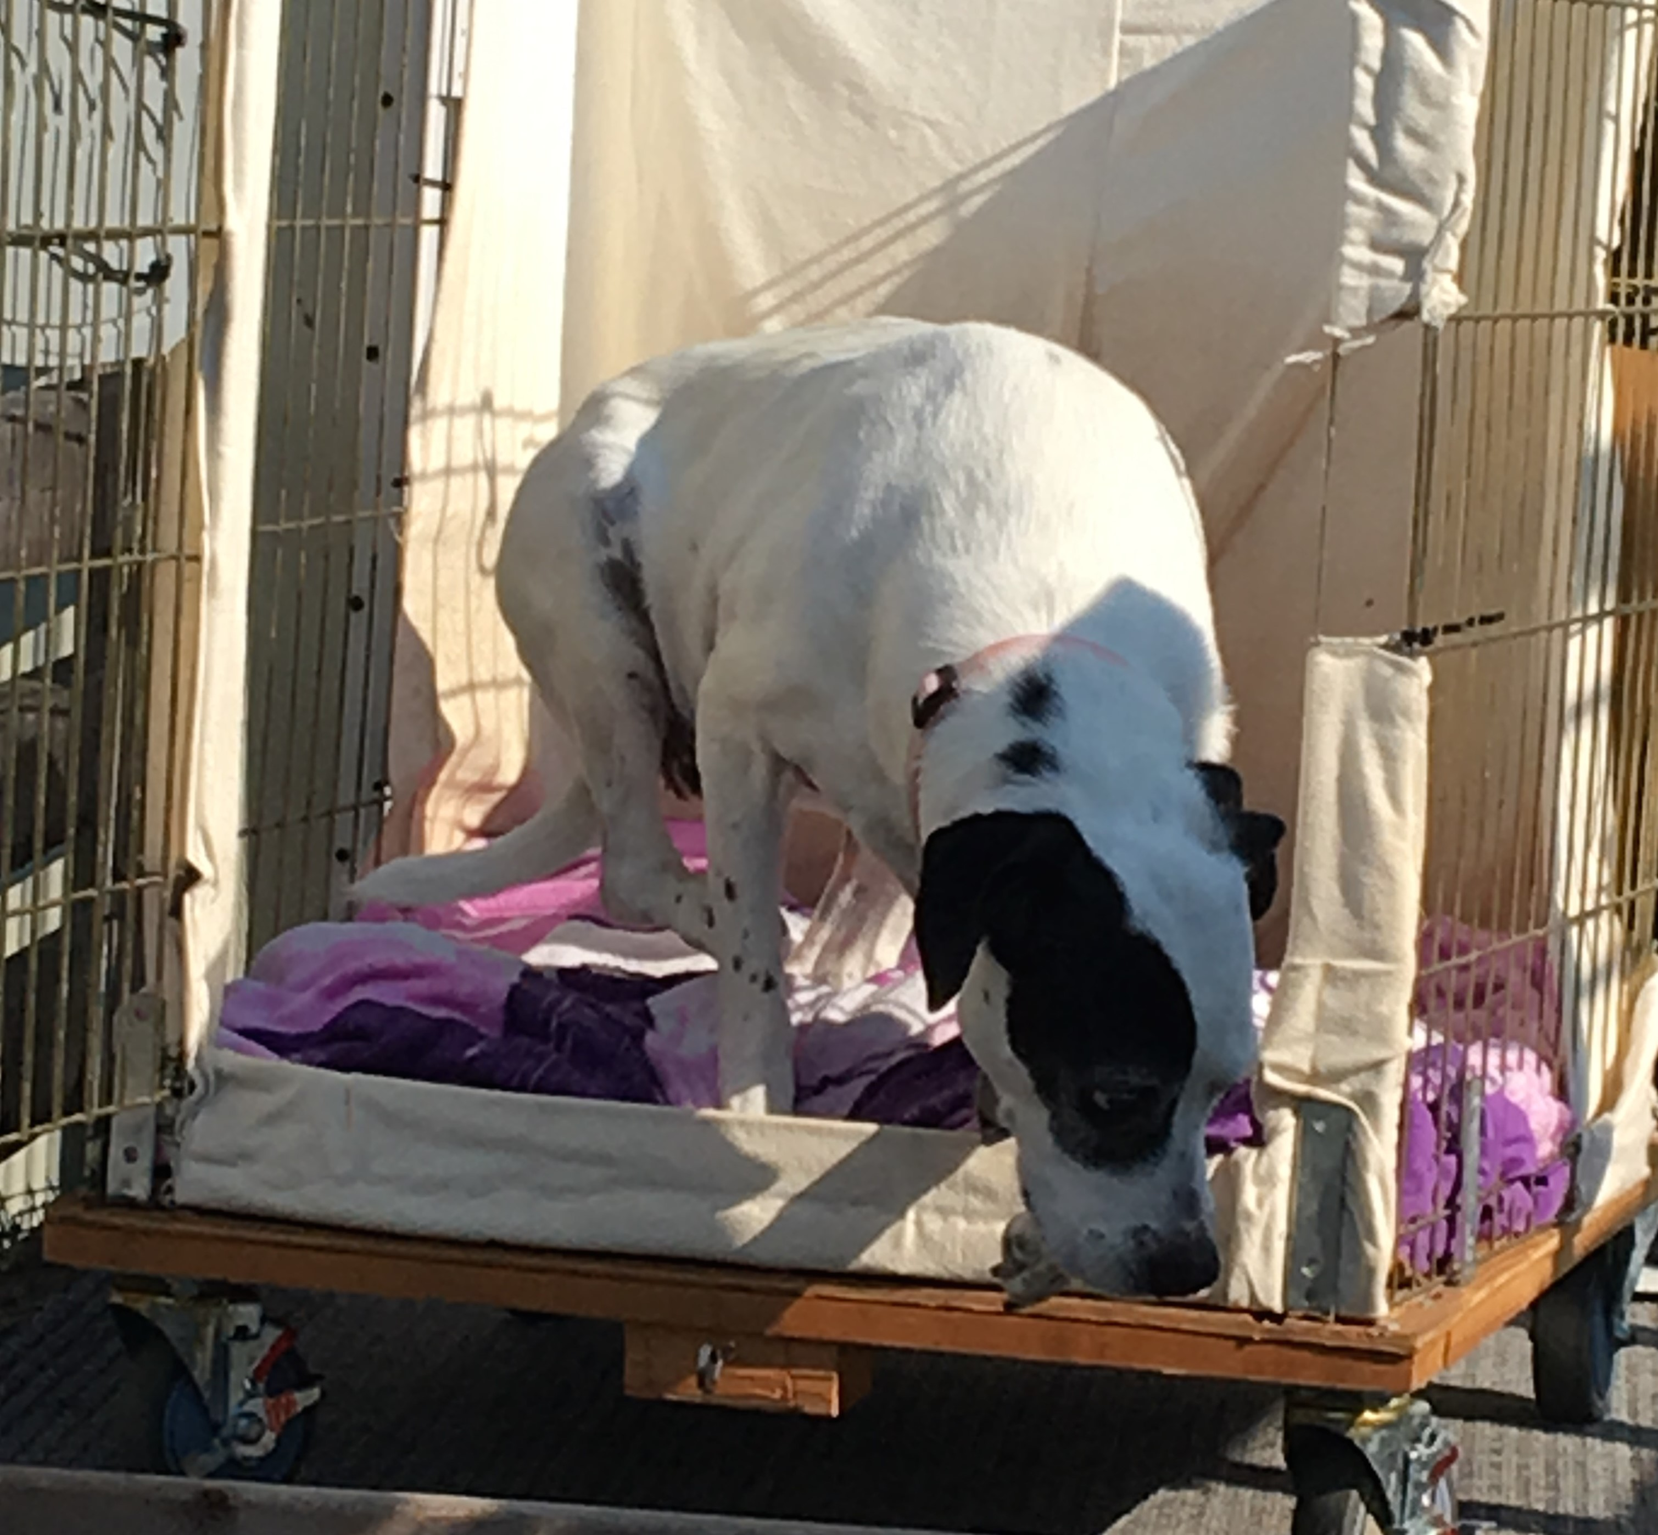
Behavior Modification

Slide 11
Behavior Modification
A type of behavioral therapy in which the principles of Operant Conditioning (reinforcement, punishments, etc.) are used to eliminate some type of unwanted, maladaptive, behavior.

Slide 12
Behavior Modification and Training (BMT) Plans
Determined based on the result of the assessment process
Protocols are chosen to address behaviors that need improving to increase the chances for adoption
BMT identified and assigned to staff for implementation

Slide 13
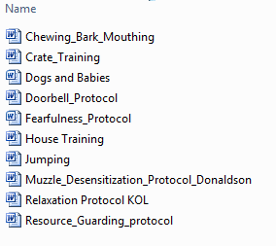
Common Behavior Protocols

Slide 14
PupPartners ™ S.P.I.R.I.T. Program
Shelter Pups & Inmate Rehabilitation & Integration Training
Thank you to our SPIRIT trainers for your commitment to improving the welfare and potential of your SPIRIT dogs!

