Slide 1
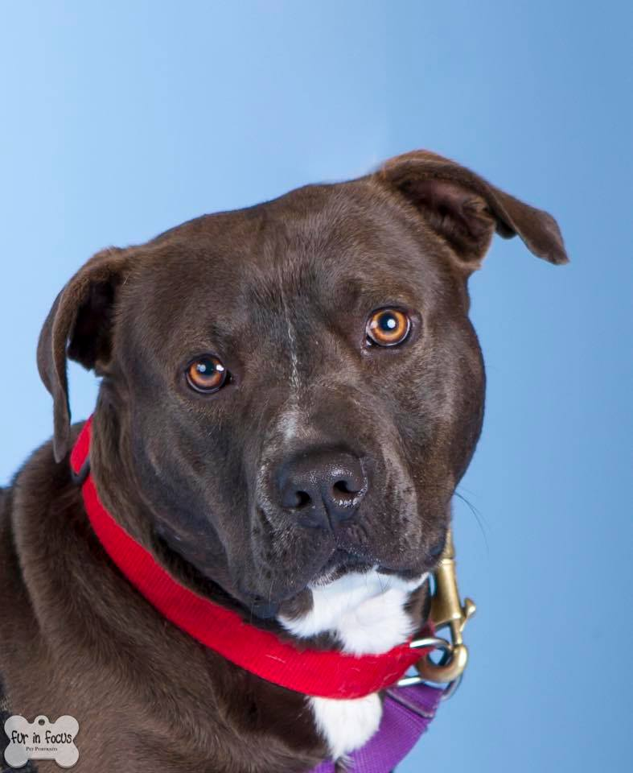
Fearful Dog Seminar
Presented by Constance Dwyer, CABC & Sara Hamburger, BMTA

Slide 2
Copyright Notice
WARNING
All rights reserved. No part of the course materials used in the instruction of this course may be reproduced in any form or by any
electronic or mechanical means, including the use
of information storage and retrieval systems,
without written approval from the copyright owner.
©2013-2016 Constance Dwyer
Training4k9s.com

Slide 3
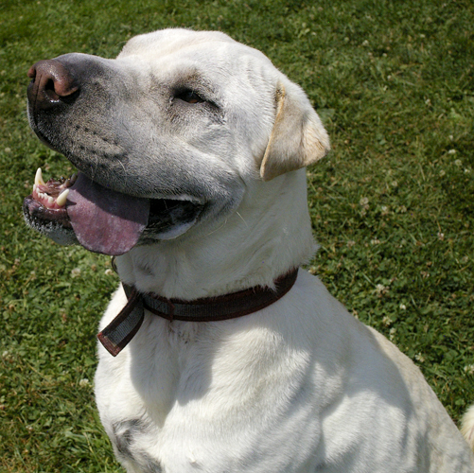
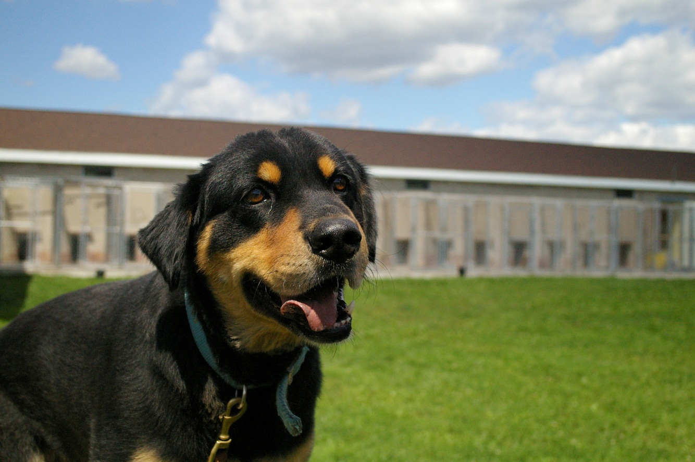
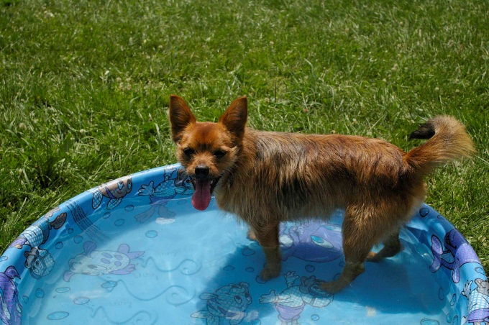
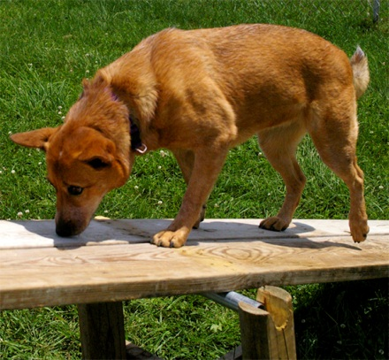
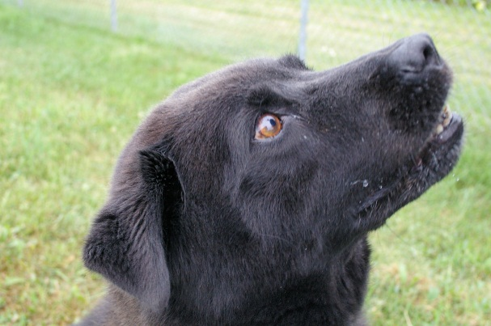
WELCOME!

Slide 4
April 23, 2015 Seminar Agenda
9:00 am – 9:15 am Safety Message / Introductions / Agenda
9:15 am – 9:45 am Fearful Body Language – distance increasing
9:45 am – 10:15 am Body Language – submissive and aggressive
10:15 am – 11:00 am Behavior Modification and Training
11:00 am – 11:15 am Break
11:30 am – 12:00 pm Behavior Modification and Training
12:00 pm – 12:30 pm Lunch and Networking
12:30 pm – 1:30 pm Case Studies
1:30 pm – 2:00 pm Playgroups and other helpful enrichment
2:00 pm – 2:30 pm Kids and Dogs
2:30 pm – 3:00 pm Wrap up / Q&A / Evaluations
Notes:
Location – ACS – Barn/Play Yard/back office
Lunch – pizza provided
Dress for the weather – indoor/outdoor seminar
Bring fold up chair is desired
Activity – sheet with body language to circle
Bring brochures/cards
Determine list of body language – hand out
Price $50 for newcomers / $40 repeat

Slide 5

Safety Message and Intros

Slide 6

Introductions
Constance Dwyer, CABC
  IAABC Certified Animal Behavior Consultant
  IAABC Shelter Behavior Affiliate
  18+ years behavior and training experience
  Animal Behavior College mentor
  Animal Care Sanctuary Animal Behavior Consultant
  AKC Canine Good Citizen Evaluator
  4H dog and horse club leader
  Lean Six Sigma Black Belt

Slide 7
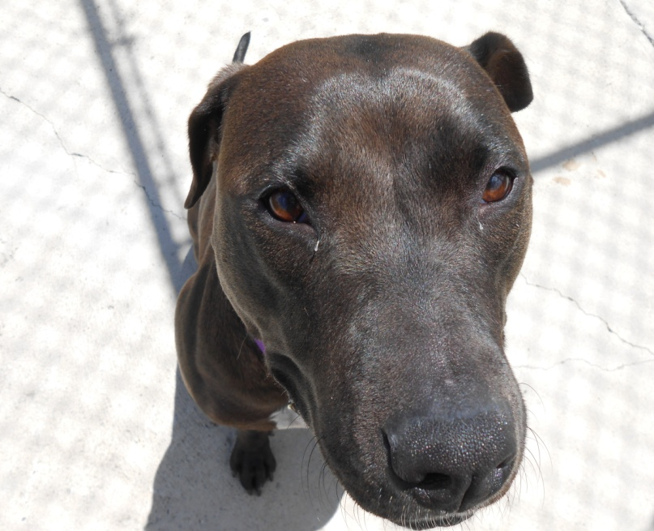
Introductions
Sara Hamburger, BMTA
    BMTA Training and Behavior Associate
    ACS Director of Enrichment and Behavior
    3 years experience in shelter behavior modification
    2 years experience in behavior consultation
    Freelance Artist!

Slide 8
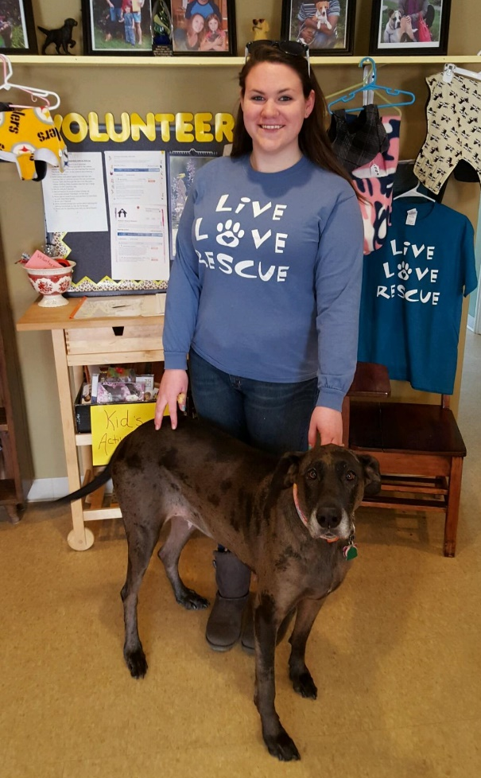
Introductions
Jessica Veach
  BMTA Training and Behavior Associate
  ACS Behavior Team Staff
    Med Team
    Enrichment Team

Slide 9
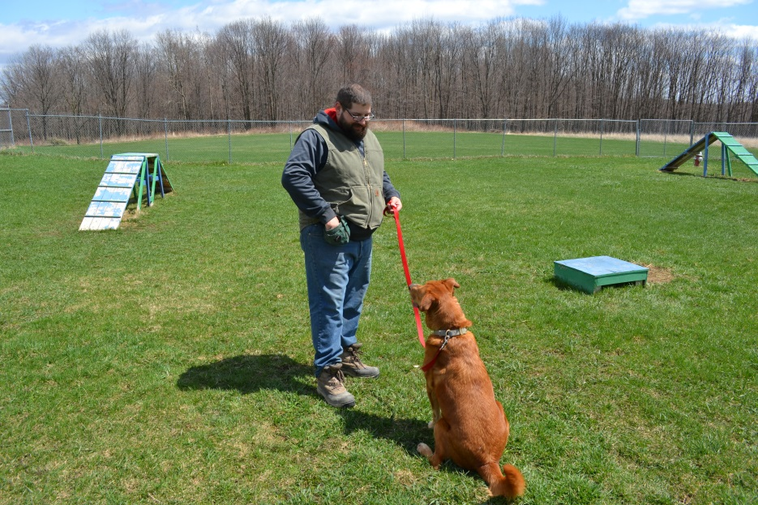
Introductions
Seth Renzi
  BMTA Training and Behavior Associate
  ACS Behavior Team staff

Slide 10
Fearfulness in Dogs
Today we will explore ways to understand and work with fearful dogs to improve their lives and ours.
Studies show that fearfulness tops the list for reasons dogs are brought to shelters. One study found that over 50% of dogs exhibited fearfulness as the most prevalent reason for return to the shelter. [1]
We will begin by discussing body language signs. This will be review for some of you who have attended our previous seminars and will be new for others.

Slide 11
Distance Increasing Signals
Definition: Canine behaviors which are displayed to convince a person or animal to move away. Often described as aggressive or invasive signals but can also be more subtle or passive.
Think of this from the perspective of the dog as the fearful dog is communicating a desire to INCREASE the distance between them and who or what they are afraid of.

Slide 12
Distance Increasing – invasive
Forward body stance
Mouth open
C shaped lips
Teeth bared
Stillness / Freeze
Targeting / Pointing
Paw lift
High tail
Ears forward
Muzzle punch
Raised hackles
Hard stare
Wide eyes
Dilated pupils
Punctuated barking
Growling
Lunging
Whiskers forward
Tight closed mouth
Height seeking
Flattened ears
Notes:
Invasive as they are meant to invade the space between them and the other person/animal.

Slide 13
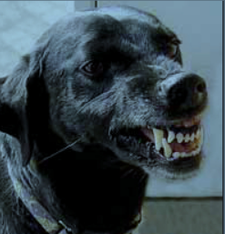
Distance Increasing - invasive
Appears to us as an aggressive dog but may actually be a fearful dog using distance increasing signals to warn us to move away.
Hard Stare / Freeze
Teeth Bared
Notes:
Seen by us as

Slide 14

Distance Increasing - invasive
Open
C shaped mouth
Flattened Ears

Slide 15
Distance Increasing – passive/stress
Stillness / Freeze
Lowered body stance
Lowered head
Paw lift
Tail tucked
Ears flat
Tap out
Panting
Look away
Averted eyes
Whale eye
Tongue flick
Hyper Salivation
Lip licking
Dander
Shedding

Slide 16
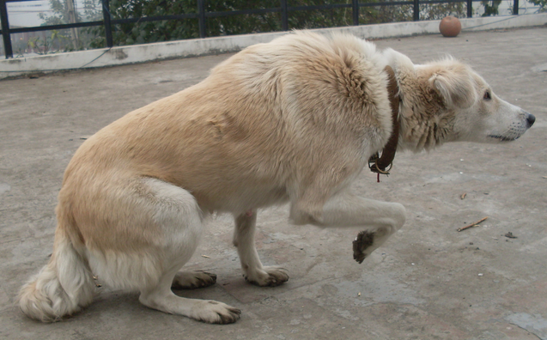
Distance Increasing - passive
Lowered Head
Lowered Body
Paw Lift
Tail Tucked

Slide 17
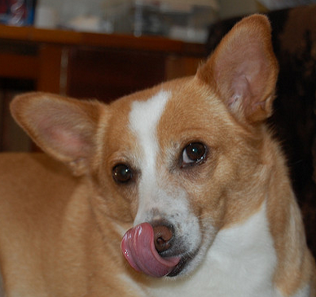

Distance Increasing - passive
Averted Eyes
Whale Eyes
Whale Eye
Tongue Flick

Slide 18
Behavior Modification & Training
This section will discuss desensitization and counter conditioning techniques which are often used to help fear related behavioral challenges of dogs.
We will also have a live demo of these techniques later today for you to gain first hand knowledge of how to administer them successfully.

Slide 19
Steps to a successful program
Assessment - Identify what evokes fear in your dog – is it small children, older people, sounds etc.
Management - Consider the use of tools which can be employed to help keep your dog and others safe while you begin your behavior modification work.
Improvement - Define and implement a behavior modification and training plan.
Monitor progress, adjust plan and continue your work.

Slide 20
Steps to a successful program
Identify what evokes fear in your dog – is it small children, older people, sounds etc.
    Find your dog’s threshold for the fear trigger. Does it go into effect when a child approaches and is within 5 feet from the dog? Make note of this distance and then move back to 6 feet and start your behavior modification there.
    If the threshold is a sound then find the volume where your dog is comfortable and begin your counter-conditioning here.

Slide 21
Steps to a successful program
Management tools can be employed to help keep your dog and others safe while you begin your behavior modification.
    Leash
    Crate
    Baby gate
    Muzzle
    Increasing distance to trigger
    Body blocking a visual trigger
Notes:
Give example of fear of children. Use a leash or barrier such as a baby gate to keep the child and dog safe.

Slide 22
Steps to a successful program
Define and Implement the behavior modification plan.
Desensitization
    Exposure to the trigger at a level just below threshold to keep your dog in a calm frame of mind
Counter-conditioning
    Pairing a high value reinforcer ( steak, chicken, etc.) with the fear inducing stimulus with intent to change the dog’s emotional state from fearful to content and relaxed.

Slide 23

Break and Networking – 15 minutes

Slide 24
Behavior Modification & Training
This section will discuss desensitization and counter conditioning techniques as used within protocols.
We will also have a hands on demo of these techniques for you to gain first hand knowledge of how to administer them successfully.

Slide 25
Fear of Strangers Management Tool
Muzzle Training for safety
  Implemented correctly a dog should readily accept and look forward to wearing a muzzle!
  A printout of our protocol will be made available
  Clicker muzzle training article http://www.clickertraining.com/node/3948
  Video of muzzle training protocol
    https://www.bluecross.org.uk/pet-advice/dogs-and-muzzle-training
  Live hands on muzzle training demo
  SAFETY FIRST!
Notes:
Video and Practice training with a fake dog – video about 10 mins.

Slide 26
Behavior Mod and Training Activity
DS/CC work
How to start muzzle training
Violet will help us work to improve our skills as trainers and behavior consultants.

Slide 27
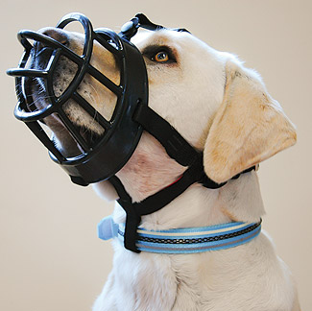
Recommended Muzzle
Baskerville Ultra
  Allows dog to pant, eat and drink
  Optional head strap for added safety
  Be sure to measure correctly
Notes:
Video and Practice training with a fake dog

Slide 28
Fear of Strangers Protocol
Marking and feeding with high value treats
    When the dog is within close proximity to the stranger
    When the dog glances or looks at the stranger
    Each time you can move closer to the stranger and dog is relaxed
Bring your dog to a public location once they are ready
    Mark and feed for same as above – dog looks at other people or dogs
Never push a dog past their threshold if they are not ready. Be patient and take small steps.
Keep a journal so you can look back and see the progress as some times it may happen in very small steps
Notes:
Demo training techniques with Pork

Slide 29
Behavior Modification and Training Plans
Here is an opportunity to set up a training plan for your dog or a client’s dog. We will be handing out BMT plan templates for you to work on. Pick a dog you know needs some help to over come a fear or two.
We will then break into groups and share our plans. Once you tweak it based on colleague input we can help finalize it so you have a solid plan to implement once you get back home.

Slide 30


Lunch and Networking

Slide 31
Case Studies
The following slides will overview dogs who have overcome their fearfulness to find love and a wonderful home life.
Our first case study is about Violet. She is our live demo dog today to help us explore the techniques for the fear of strangers protocol.

Slide 32
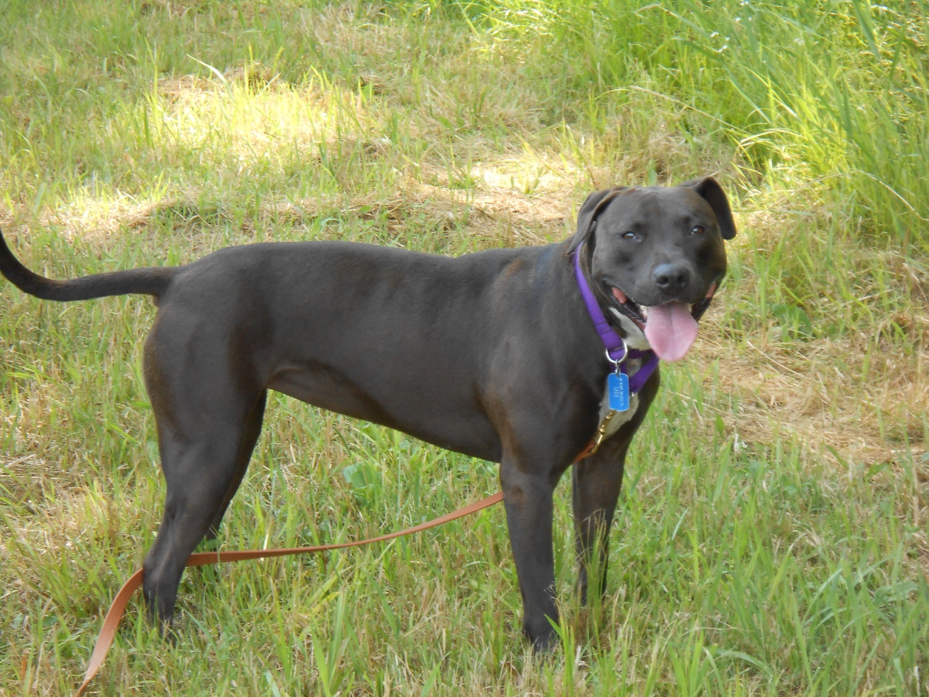
Violet

Slide 33
Violet – Case Study
Age: 6 years old
Breed: Pitbull
Previous Shelter Length of Stay (LOS) – 2.5 yrs
Current LOS – Rental home in a quiet setting – 4 yrs

Slide 34
Violet – Case study
Type of Fear
  Fear of strangers
  Fear of certain noises
  Fear of small spaces
  Fear of certain objects
  Dominance aggression towards handler

Slide 35
Violet – Case Study
Behavioral Display
  Fear behaviors are presented towards strangers by cowing, moving away, yawning, lip licking, urination, trembling, whale eyeing, head turning, defecation, and barking/growling. Violet would also show aggression by body slamming her handler, leash biting, grabbing clothing and exhibiting tugging behaviors.

Slide 36
Violet – Case study
Behavior Modification work
  Current BMT work is continuing stranger introduction through counter conditioning using R+. Currently continuing to work on calm behaviors, 4 on the floor, dog to dog introductions, and introductions to other species such as cats etc. Consistent work in impulse control over cars/bikes/cats, targeting work/muzzle work.

Slide 37
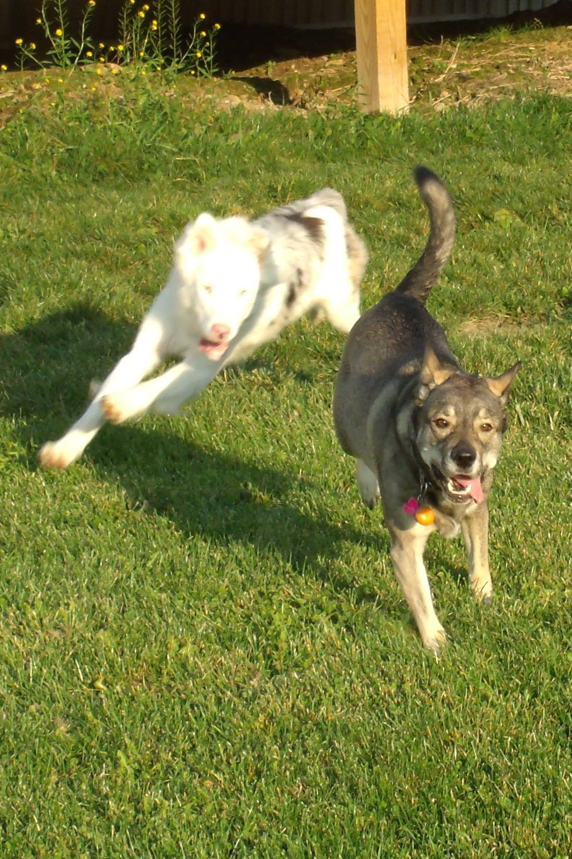
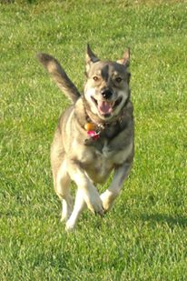
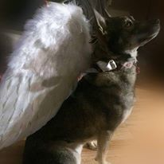
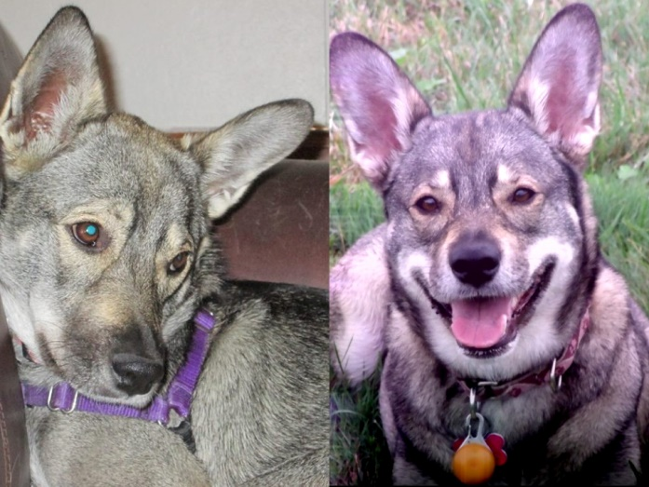
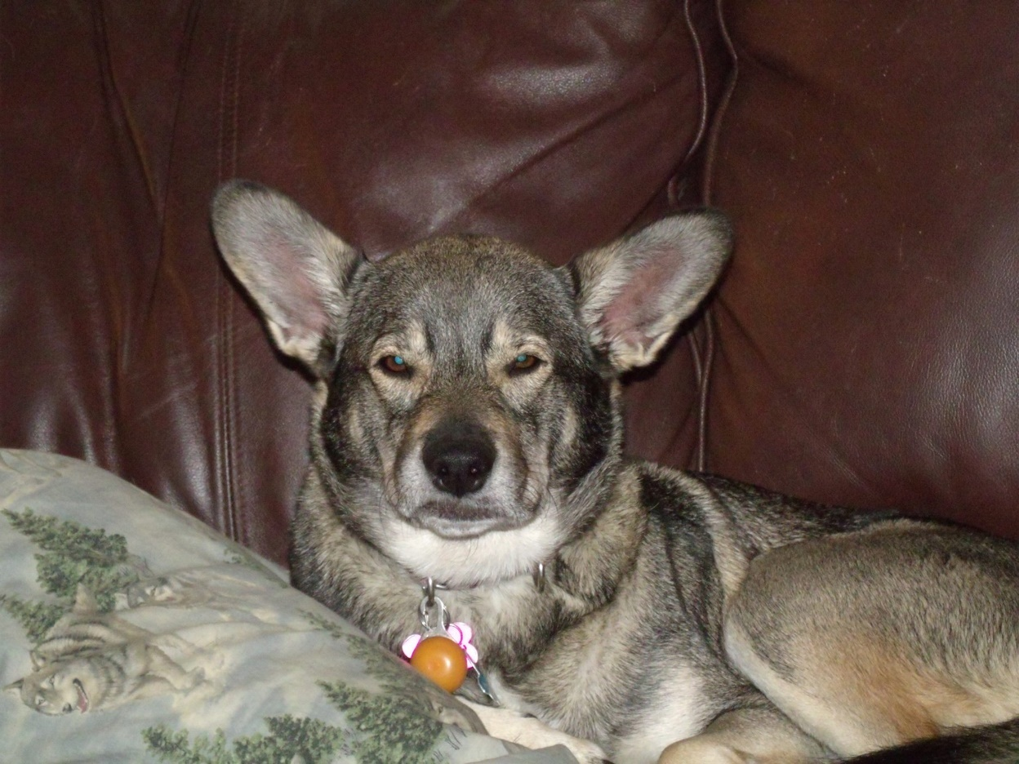
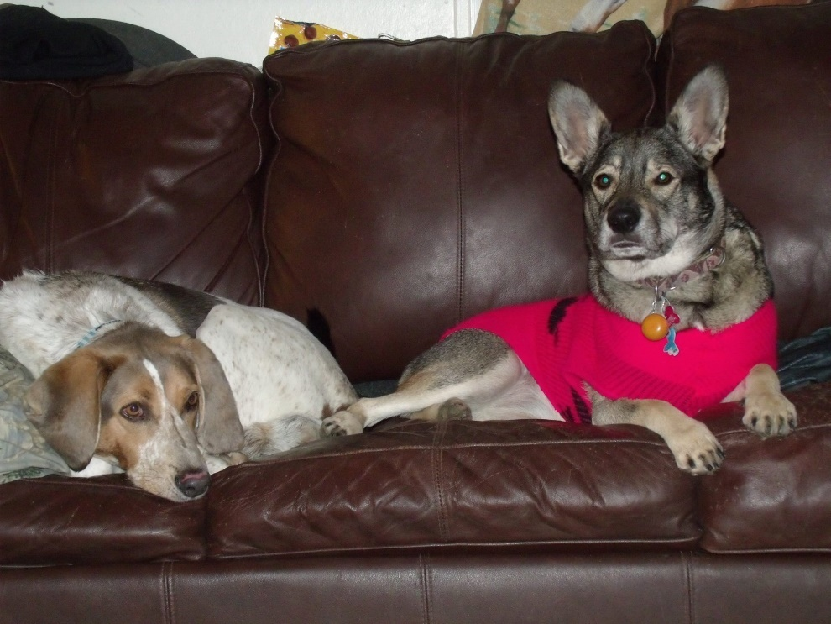
Ava

Slide 38
Ava – Case Study
Age: 4 years old
Breed: Husky/Corgi Mix (DNA tested)
Previous Shelter Length of Stay (LOS) – from 2013 – 2015 multiple returns about 7 months
Current LOS – Rental home in a quiet setting – 1.5 yrs

Slide 39
Ava – Case study
Type of Fear
  Fear of strangers
  Fear of sudden movements
  Stress with handling
  Dog and Stranger Reactivity
  Leash Biting

Slide 40
Ava – Case Study
Behavioral Display
  Fear behaviors are presented towards strangers snapping, cowering, whimpering, tenseness.

Slide 41
Ava – Case study
Behavior Modification work
  DS/CC to handling and leashing. Clicker training to teach Sit stay for leashing. Clicker training to teach her to allow gentle handling, beginning with chest and body then face and feet. DS/CC with strangers starting with treats for seeing strangers at a distance to being touched by strangers. Ava will now tolerate new people being in her space. I do still ask new people not to touch her until she is relaxed in their presence. Sudden movements sometimes still startle Ava. If I pick up her leash to quickly she will flinch and whimper. Ava has a fear of bugs, not sure if it is sight or sound or both.

Slide 42
Behavior Mod and Training Activity
Ava will help us demo clicker training and how to teach targeting as well as use it for basice obedience.
Ava will also be working on her fear of strangers

Slide 43
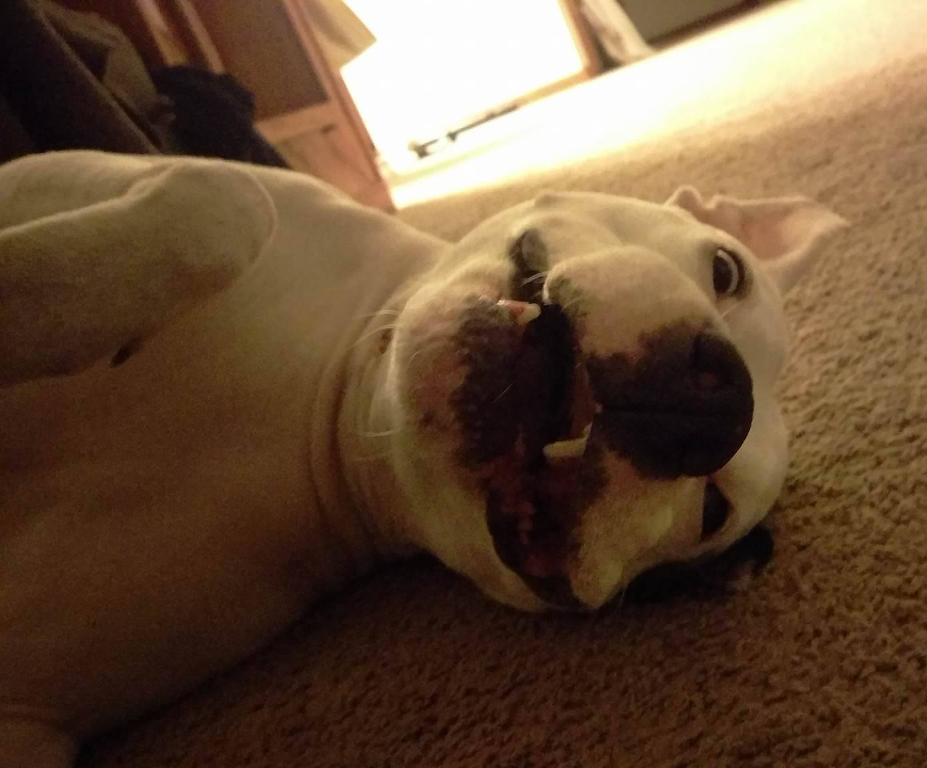
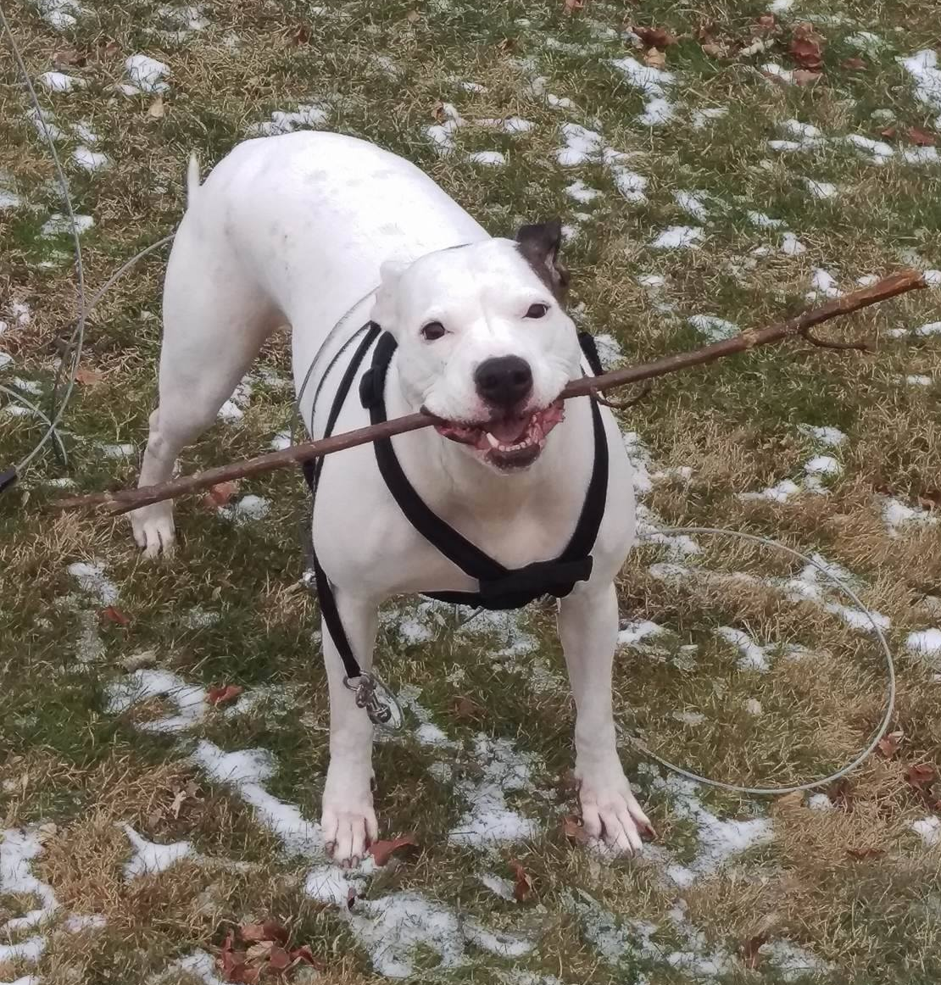
Armani

Slide 44
Armani – Case Study
Age: 8 years old
Breed: Pit bull
Previous Shelter Total Length of Stay (LOS) – 3+ yrs – (includes multiple returns to the shelter)
Current LOS – Family home – 2 yrs

Slide 45
Armani – Case study
Type of Fear
  Fear of strangers

Slide 46
Armani – Case Study
Behavioral Display
  Fear behaviors are presented towards strangers by cowering, growling and snapping.
  Stress behaviors presented as self-mutilation – rubbing against metal door frames or gnawing on her legs until they became raw.
  Lack of appetite and hiding in corner of kennel

Slide 47
Armani – Case study
Behavior Modification work
  Clicker training and diligent DS/CC work around new people for 2 years has resulted in her being comfortable around most strangers. Visits the family camp twice a year and enjoys the festivities with everyone there. Has even made friends with a 6 year old girl who adores her.
  Armani still has some stranger danger but is much more comfortable with herself and trusting of others.

Slide 48
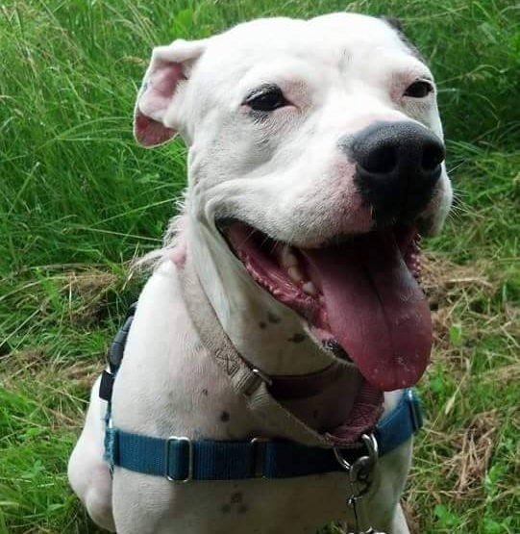
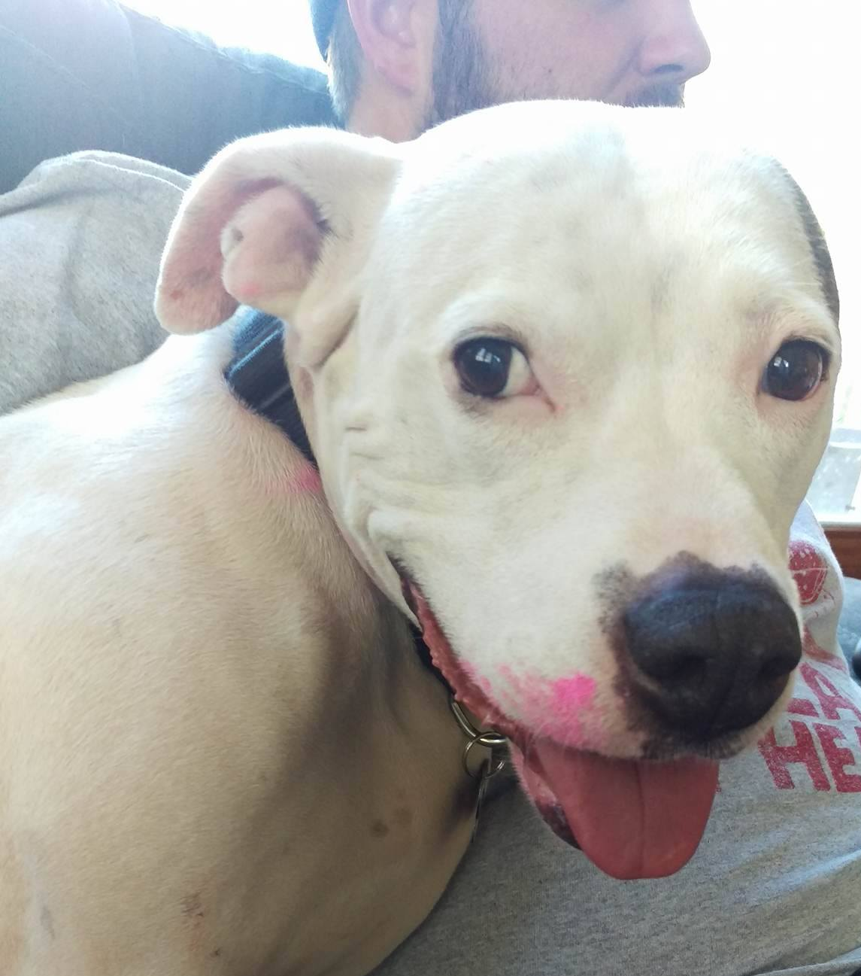
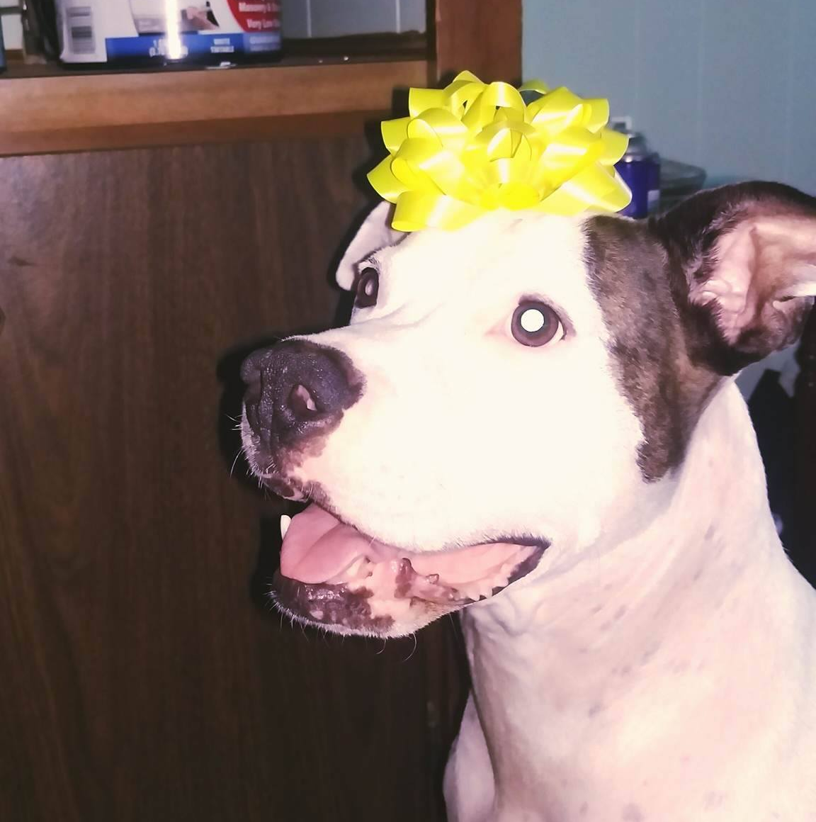
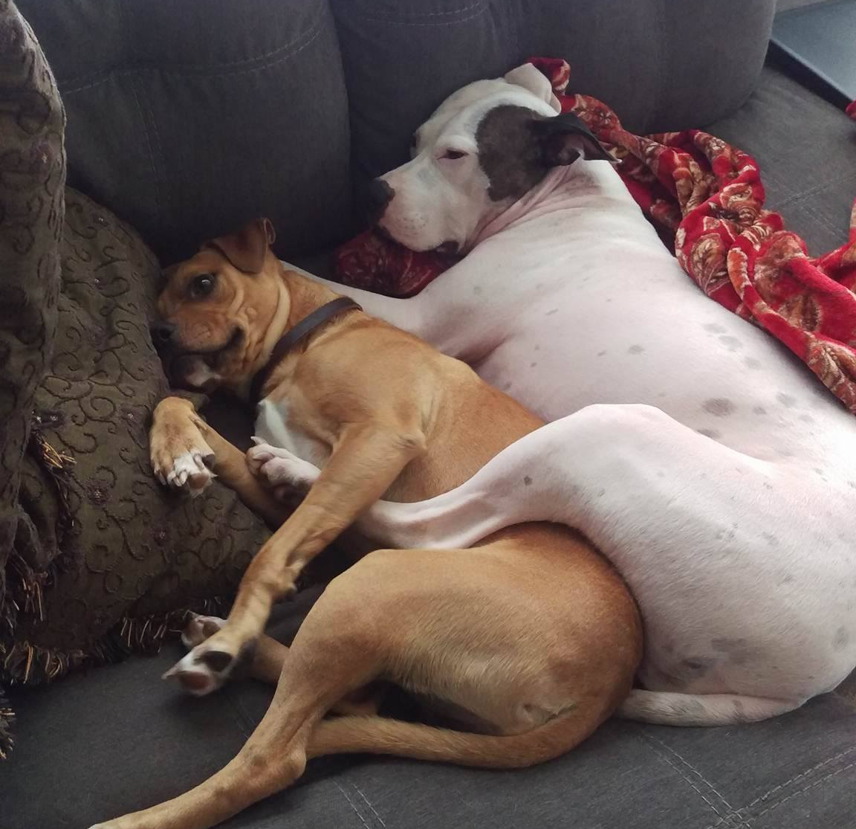
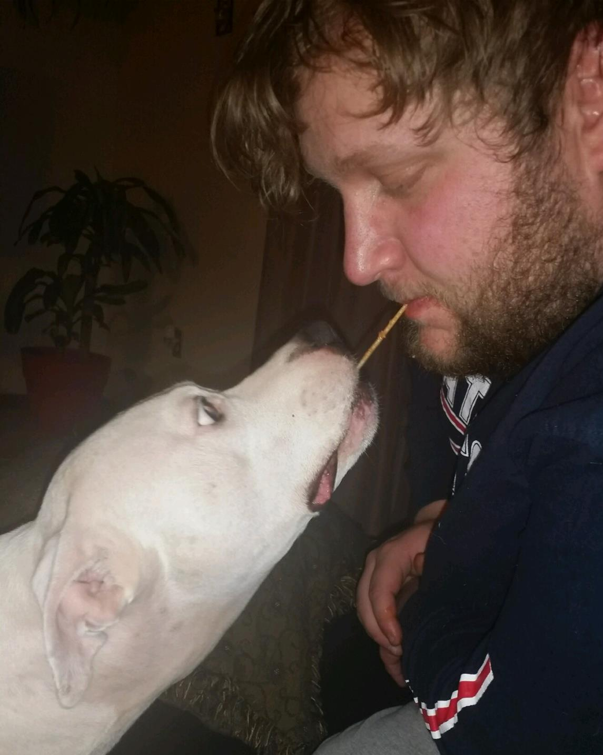
Armani – Case study

Slide 49
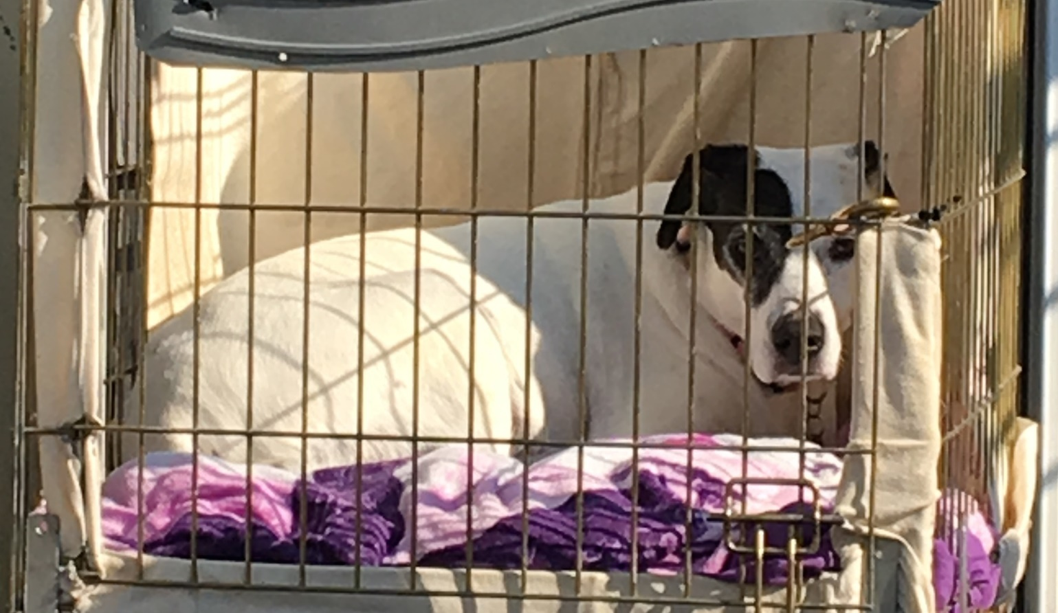
Daisy

Slide 50
Daisy – Case Study
Age: about 8.5 years old
Breed: Mixed Breed
Previous Shelter Length of Stay (LOS) – less than a month. Prior LOS 5 years hoarders small house with 45 dogs and 70 cats.
Current LOS – Rental home in a quiet setting – 3.5 yrs

Slide 51
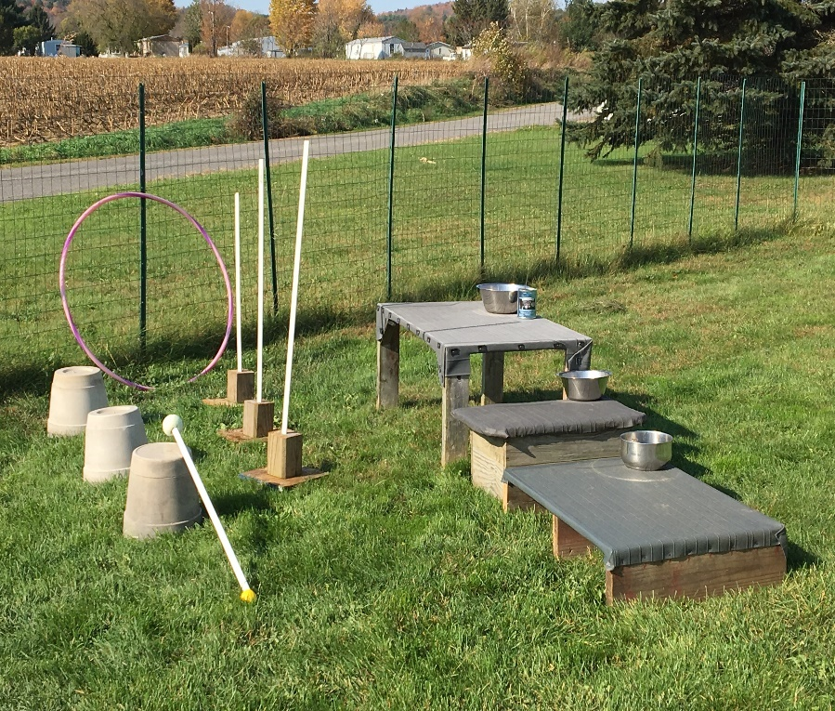
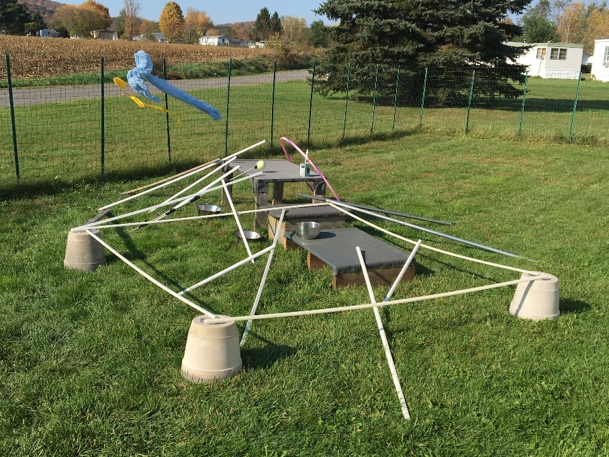
Daisy - Confidence Building Work

Slide 52
Building Confidence
Initially was afraid of everything
Would not get out of her bed and had to be carried outside to eliminate
3.5 years of caring, behavior modification and training has helped her improve immensely
Agility work helps work on her fear of different objects and situations
Daisy was a flight risk so double leashing is used
Has relapses that can last months
Xanax now replaced with Solliquin – holistic supplement

Slide 53
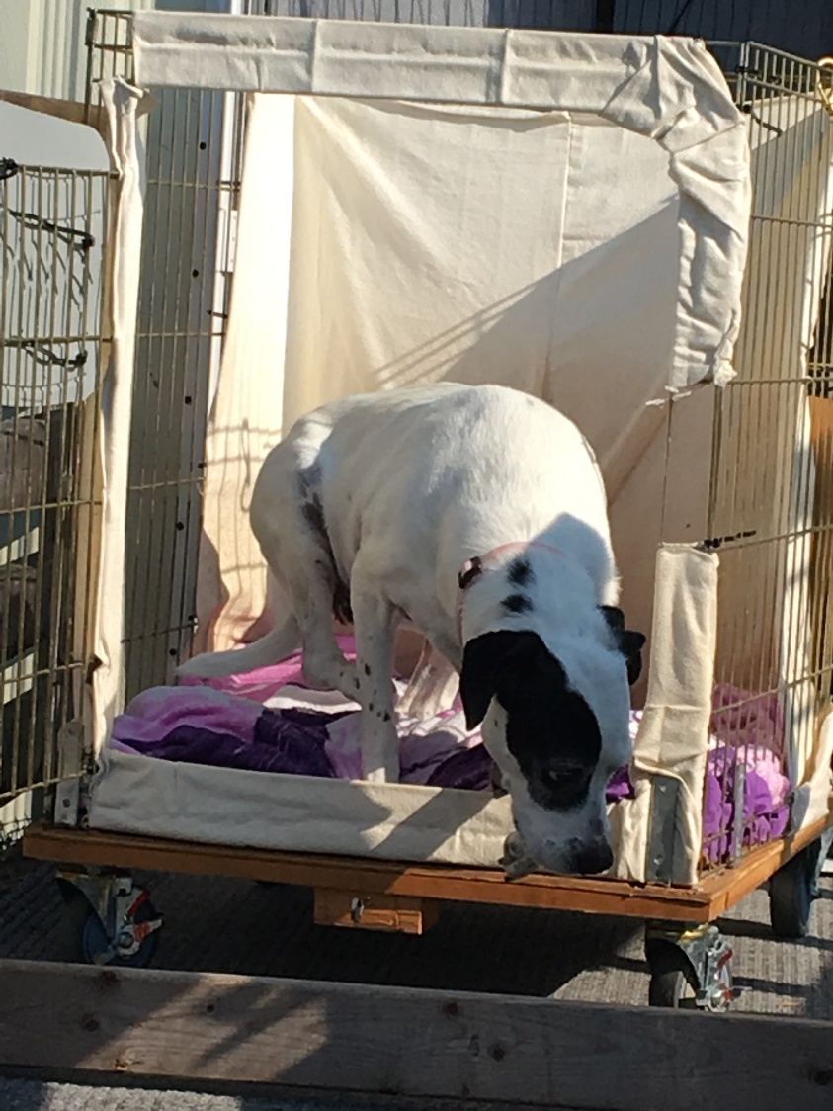
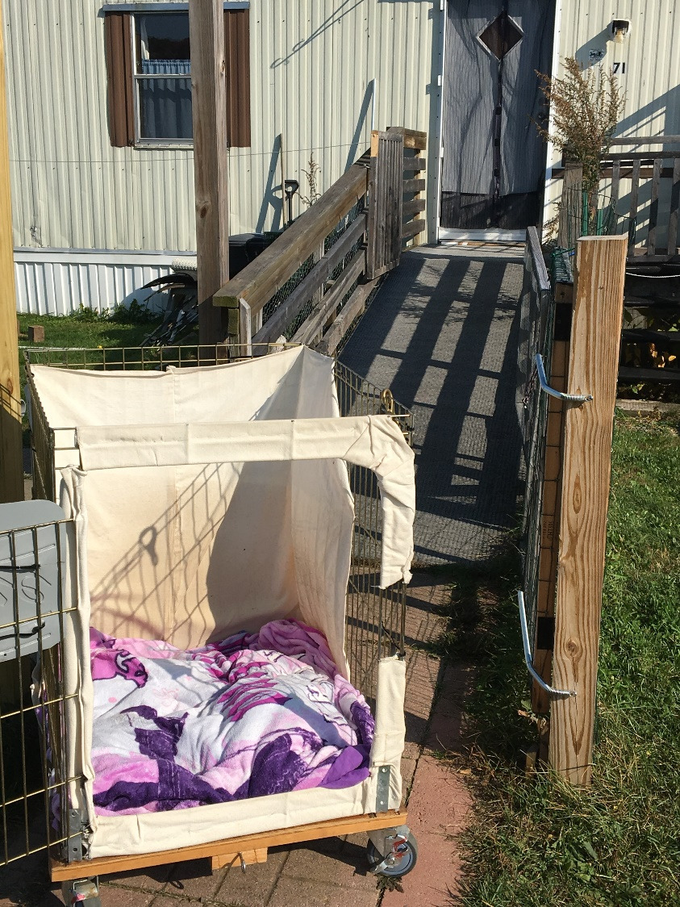
Daisy - Encouraging Up and Out

Slide 54
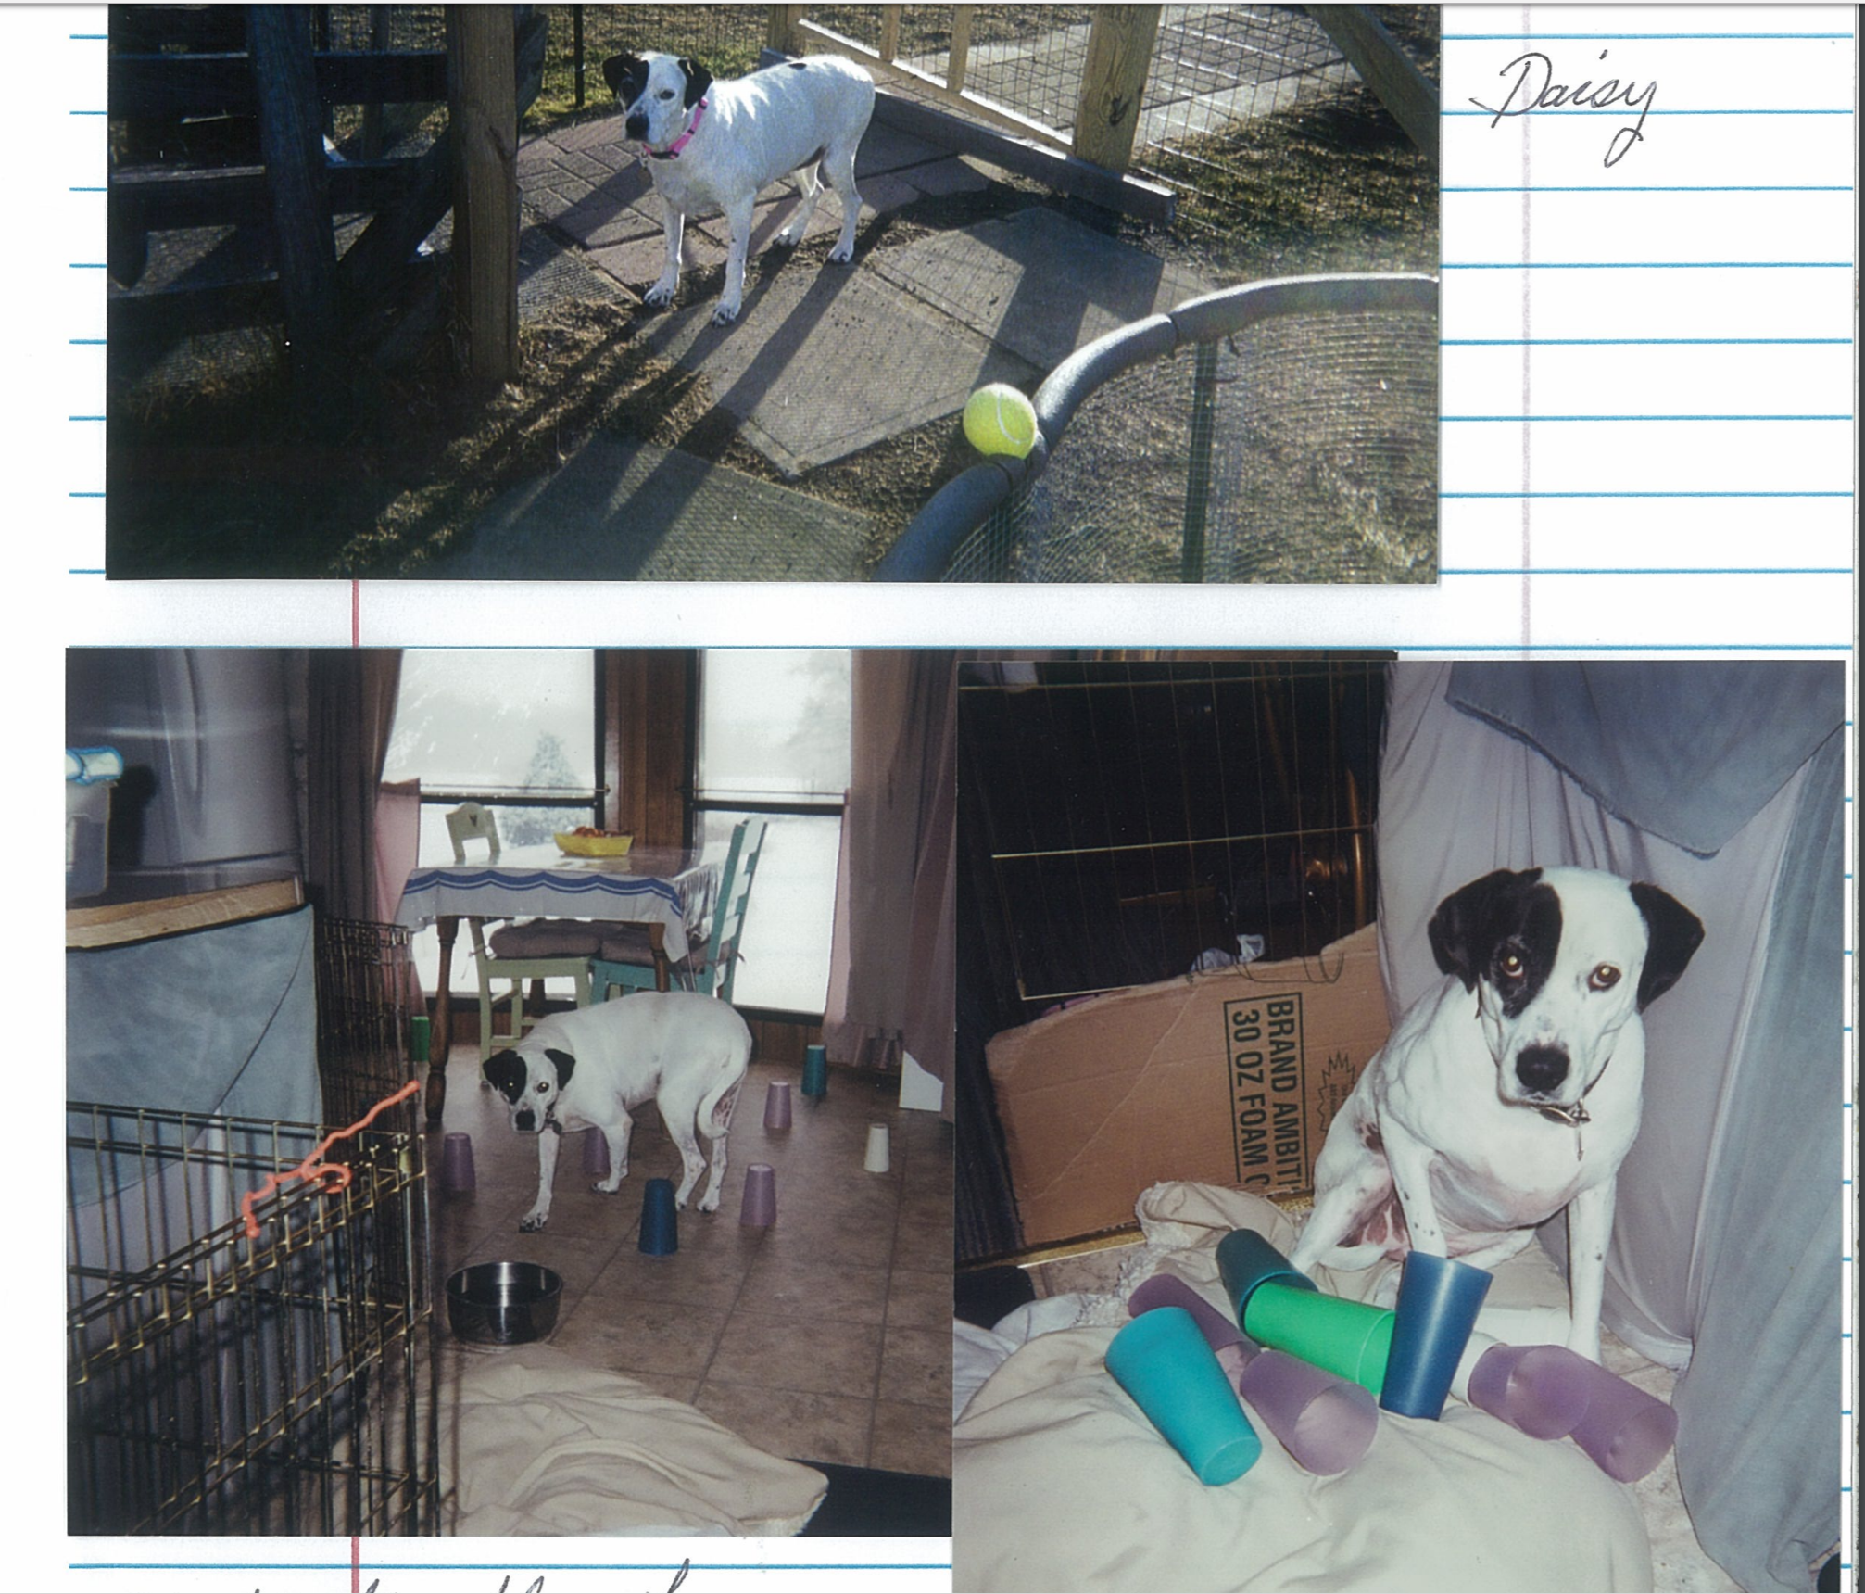
Daisy

Slide 55
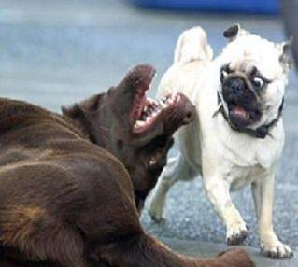
Playgroups

Slide 56
Playgroups
Benefits for shy dogs
Link to video of the impact of dog-to-dog behavior work on completely shut down shy dog.
https://www.youtube.com/watch?v=PnwuGa8JmGA had to be carried to leave her kennel - but with another dog she would follow. This was her first time out of her kennel. This was three days later after first video.
https://www.youtube.com/watch?v=lPE9OAQ3YaE
Credit: Sacramento County Animal Shelter

Slide 57
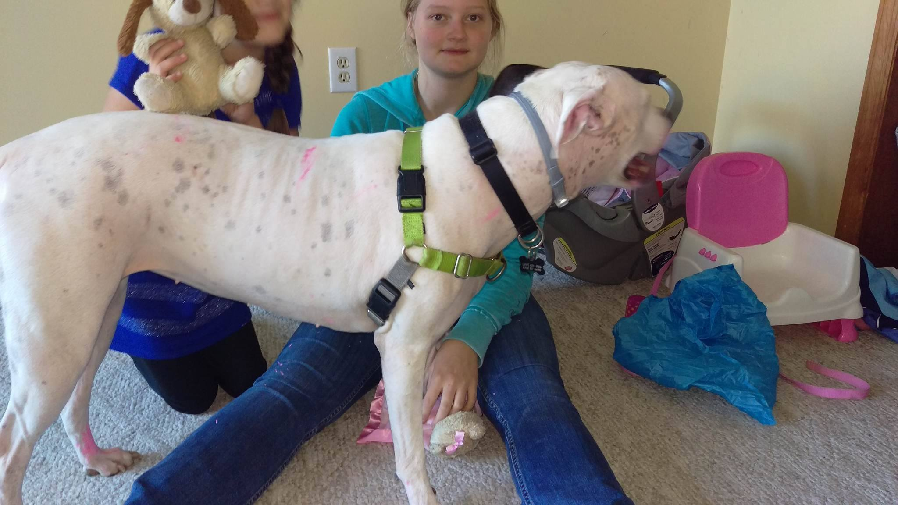
Kids and Dogs

Slide 58
Kids and Dogs – Do’s and Don’ts
Introduce your dog to children slowly using the DS/CC protocol we discussed earlier
Explain to children not to pet a dog unless they ask you if it is ok
NEVER, NEVER!! leave any child alone with a dog
We recommend that children be 12 years and older for fearful passive (yellow) dogs and 18 years old for fearful aggressive dogs (purple).

Slide 59
Blind and Deaf Dogs

Slide 60
Blind and Deaf Dogs
Blind dogs can still be trainable via a sound marker such as the click
Blind and Deaf are special cases.
  Vibrating collars can work well as markers for your DS/CC work to build confidence
  Work as slow as necessary to introduce the vibration starting with a very mild vibration, enough for your dog to feel it. Pair this with the best food treat until it becomes a conditioned reinforcer as we do with the clicker.

Slide 61
Fearful Dogs Resources
D.L. Wells P.G. Hepper – Prevalence of behavior problems reported by owners of dogs purchased from an animal rescue
"The Cautious Canine" by Patricia McConnell Ph.D.
- covers classical conditioning and desensitization process.
"Calming Signals On Talking Terms with Dogs" By Turid Rugaas.
-illustrates dog body language, displacement displays, appeasement gestures. A videotape is also available on Calming Signals.
"Don't Shoot The Dog" by Karen Pryor
-a book about how all animals, including humans, learn.
https://deafdogsrock.com/vibration-collar-training-on-a-deaf-blind-dog-braille
Fearfuldogs.com – Debbie Jacobs website
A Guide to Living with & Training a Fearful Dog – Debbie Jacobs

Slide 62

Questions?

