Slide 1
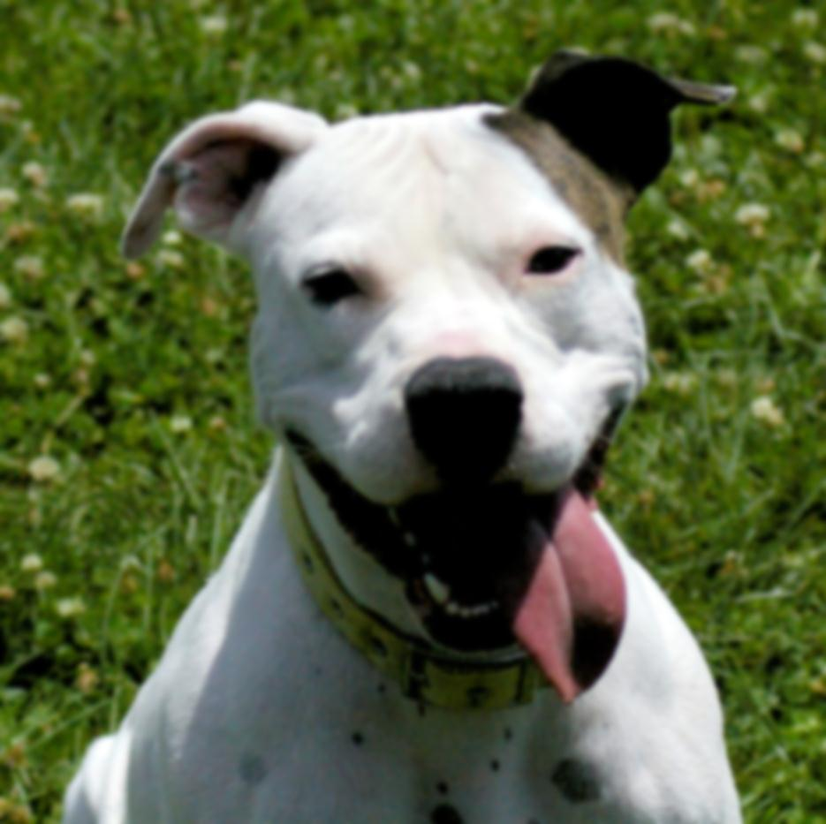
Making Shelter Life Positive
Presented by
Constance Dwyer, CABC; Sara Hamburger, BMTA; Kathryn Boccia, ABCDT; Jill Elston, LVT

Slide 2
Copyright Notice
WARNING
All rights reserved. No part of the course materials used in the instruction of this course may be reproduced in any form or by any
electronic or mechanical means, including the use
of information storage and retrieval systems,
without written approval from the copyright owner.
©2013-2017 Constance Dwyer
Training4k9s.com

Slide 3
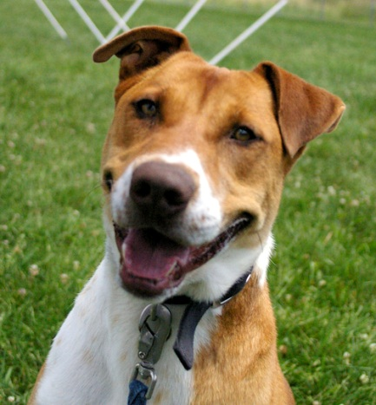
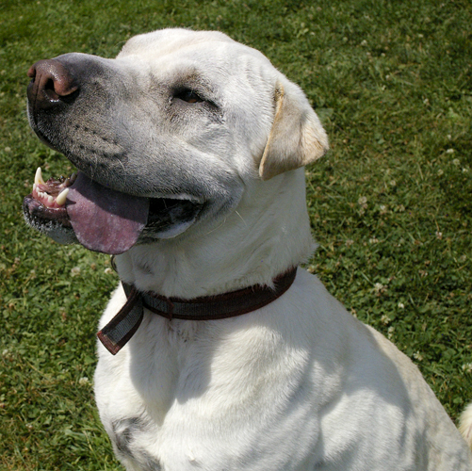
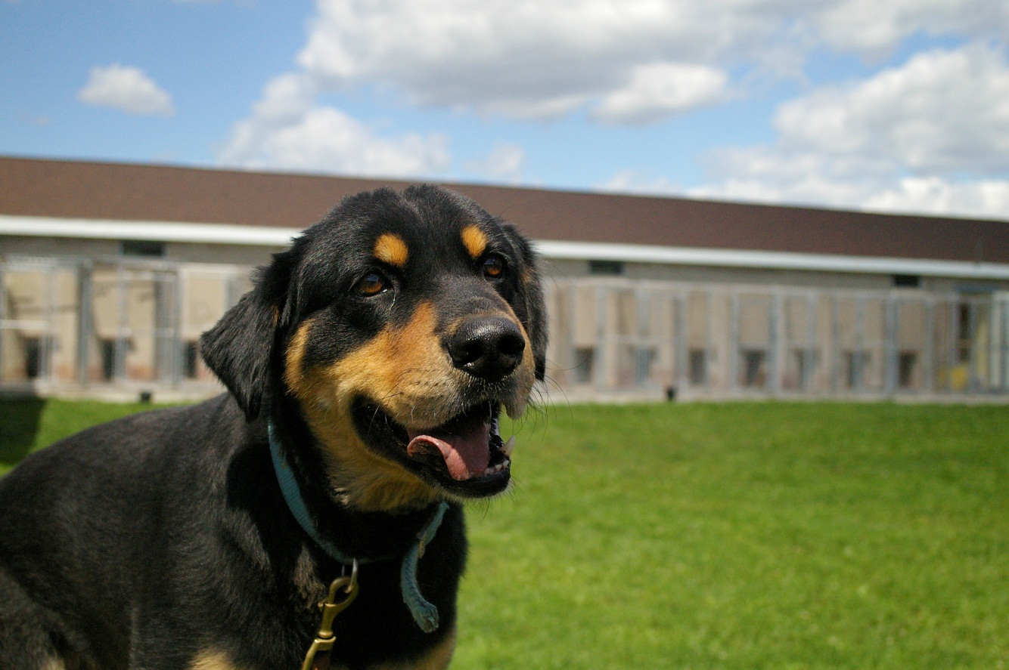
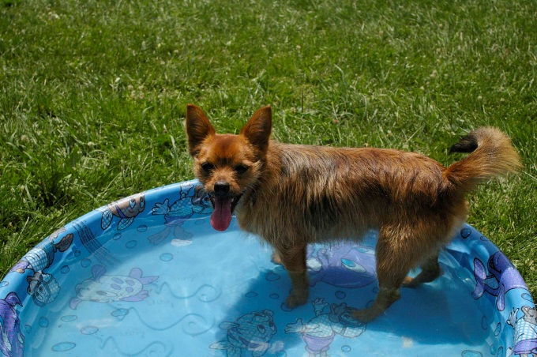
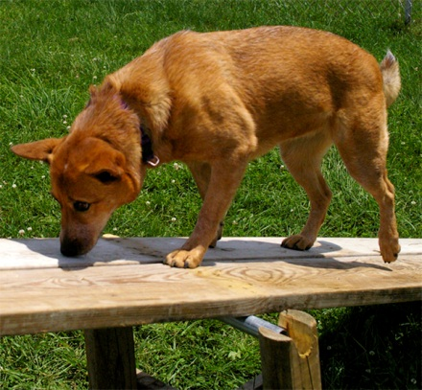
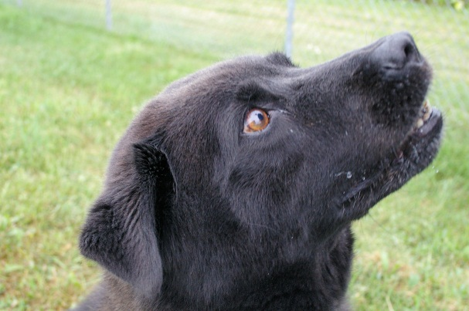
WELCOME!

Slide 4

Safety Message and Intros

Slide 5

Introductions
Constance Dwyer, CABC
  IAABC Certified Animal Behavior Consultant
  19+ years behavior and training experience
  Animal Behavior College mentor
  AKC Canine Good Citizen Evaluator
  Animal Care Sanctuary Behavior Consultant
  Love on a Leash Therapy Dog Evaluator
  4H dog and horse club leader
  Lean Six Sigma Black Belt

Slide 6
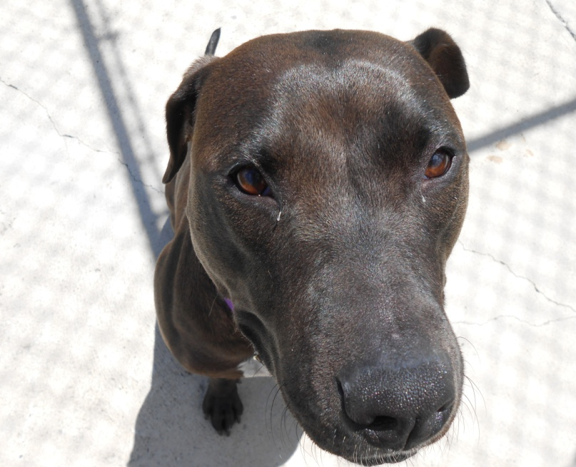
Introductions
Sara Hamburger, BMTA
    BMTA Training and Behavior Associate
    ACS Director of Enrichment and Behavior
    5 years experience in shelter behavior modification
    4 years experience in behavior consultation
    Freelance Artist!

Slide 7
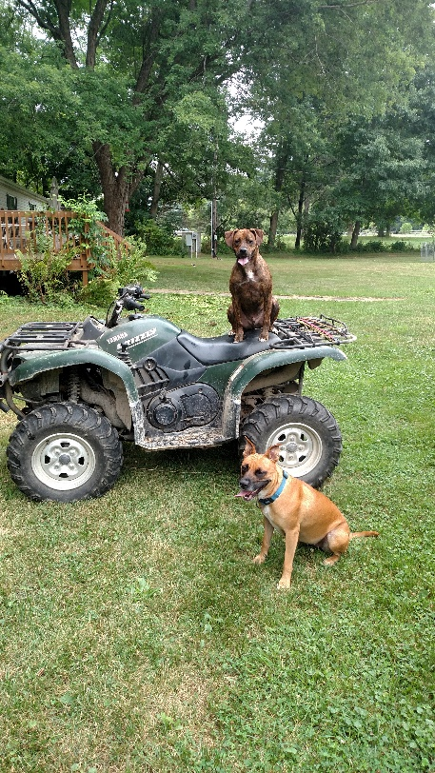
Introductions
Kathryn Boccia
  Honor Graduate, Animal Behavior College
  IAABC Supporting Member
  Doggone Safe Dog Bite Safety Educator
  AKC Canine Good Citizen Evaluator
  Lean Six Sigma Yellow Belt

Slide 8
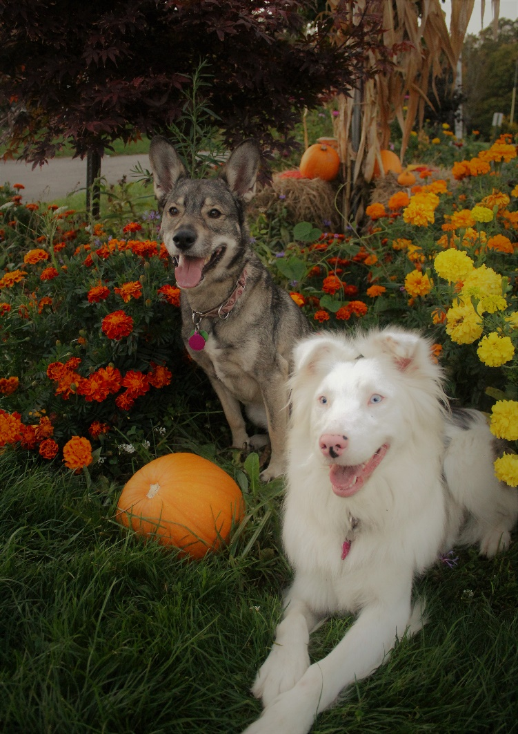
Introductions
Jill Elston
  IAABC Shelter Division Affiliate
  Licensed Veterinary Technician
  6+ years experience in
  Shelter Medicine and
  Shelter Animal Welfare

Slide 9
October 14, 2017 Seminar Agenda
8:30 am – 9:00 am Registration and Breakfast
9:00 am – 9:15 am Introductions and Overview of day
9:15 am – 9:45 am Learning Quadrant – Lecture
9:45 am – 10:15 am Training Game – Hands-on learning
10:15 am – 10:30 am Break
10:30 am – 11:00 pm +R Shaping with shelter dogs – Hands-on
11:00 am – 11:30 am Safety Working with Dogs
11:30 am – 12:00 pm Stress Free Vet Care
12:00 pm – 12:30 pm Networking / Break
12:30 pm – 12:45 pm Body Language – Lecture / Videos
12:45 pm – 1:00 pm Dog Introductions – Lecture / Videos
1:00 pm – 1:15 pm Playgroups – Lecture / Videos
1:15 pm – 1:30 pm Break
1:30 pm – 2:30 pm Pup Partners ™ Shelter Package
2:30 pm – 2:45 pm Pup Partners ™ S.P.I.R.I.T Program
2:45 pm – 3:15 pm Enrichment – Lecture / Videos
3:15 pm – 4:00 pm Wrap up / Q&A

Slide 10
Learning Theory

Slide 11
Reinforcements
Positive
  involves the addition of a stimulus following a behavior that makes it more likely that the behavior will occur again in the future.
Negative
  involves strengthening a behavior through the removal of an aversive stimulus.
+R
-R

Slide 12
Reinforcements - examples
Positive
  Real life examples
    Treats
    Praise
    Play
    ???
Negative
  Real life examples
    Ear pinching
    Loose leash walking
    ???

Slide 13
Punishments
Positive
  involves the addition of an aversive stimulus following a behavior that makes it more likely that the behavior will decrease/weaken in the future.
Negative
  involves the removal of a desirable stimulus following a behavior that makes it more likely that the behavior will decrease/weaken in the future.
+P
-P

Slide 14
Punishments - examples
Positive
  Real life examples
    Yelling at the dog
    Collar “correction”
    Stepping on their toes
    Kneeing in the chest
    ???
Negative
  Real life examples
    Crate time out
    Turning your back
    Changing direction
    ???

Slide 15
Learning Quadrant Exercise
+R
Positive Reinforcement
-R
Negative Reinforcement
+P
Positive
Punishment
-P
Negative Punishment
Decreases Behavior Increases Behavior

Slide 16
Operant Conditioning
Type of learning in which an individual's behavior is modified by its consequences.
Operant conditioning is a term that was coined by B.F.Skinner. Operant conditioning is distinguished from classical conditioning in that operant conditioning deals with the modification of voluntary or operant behavior.

Slide 17
Classical Conditioning
Marker or Clicker Training
previously neutral stimulus (the click sound) is known as a Conditioned Stimulus that provokes a Conditioned Response (anticipation of food or something else the dog wants – toys, play).
Discovered by Psychologist Ivan Pavlov
– Pavlov’s Dogs

Slide 18
Why do we care?
As instructors and trainers we want to strengthen safe, positive associations to build trust, companionship and life long partnerships between humans and dogs.
Who are your friends and loved ones?
What relationships do you have with them?
What are they built on?

Slide 19
Hands On Learning
+R Behavior Shaping Game
  1person is a trainer
  1 person is a trainee
  No verbal directions
  Human behaviors
  Use clicker (marker) to communicate

Slide 20
Networking / Break

Slide 21
Hands On Learning
+R Behavior Shaping with Shelter Dogs
  Break up into smaller groups
  Work with FLSPCA staff and dogs
  Shape basic behaviors – sit, down etc.
  Loose leash walking instruction

Slide 22
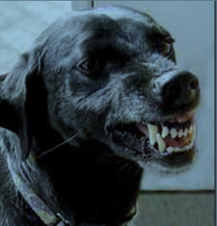
Dog Bite Safety
Handling Aggressive Dogs

Slide 23

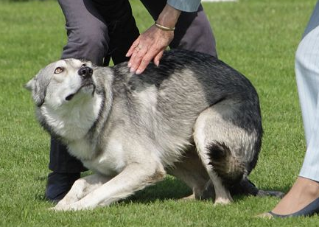
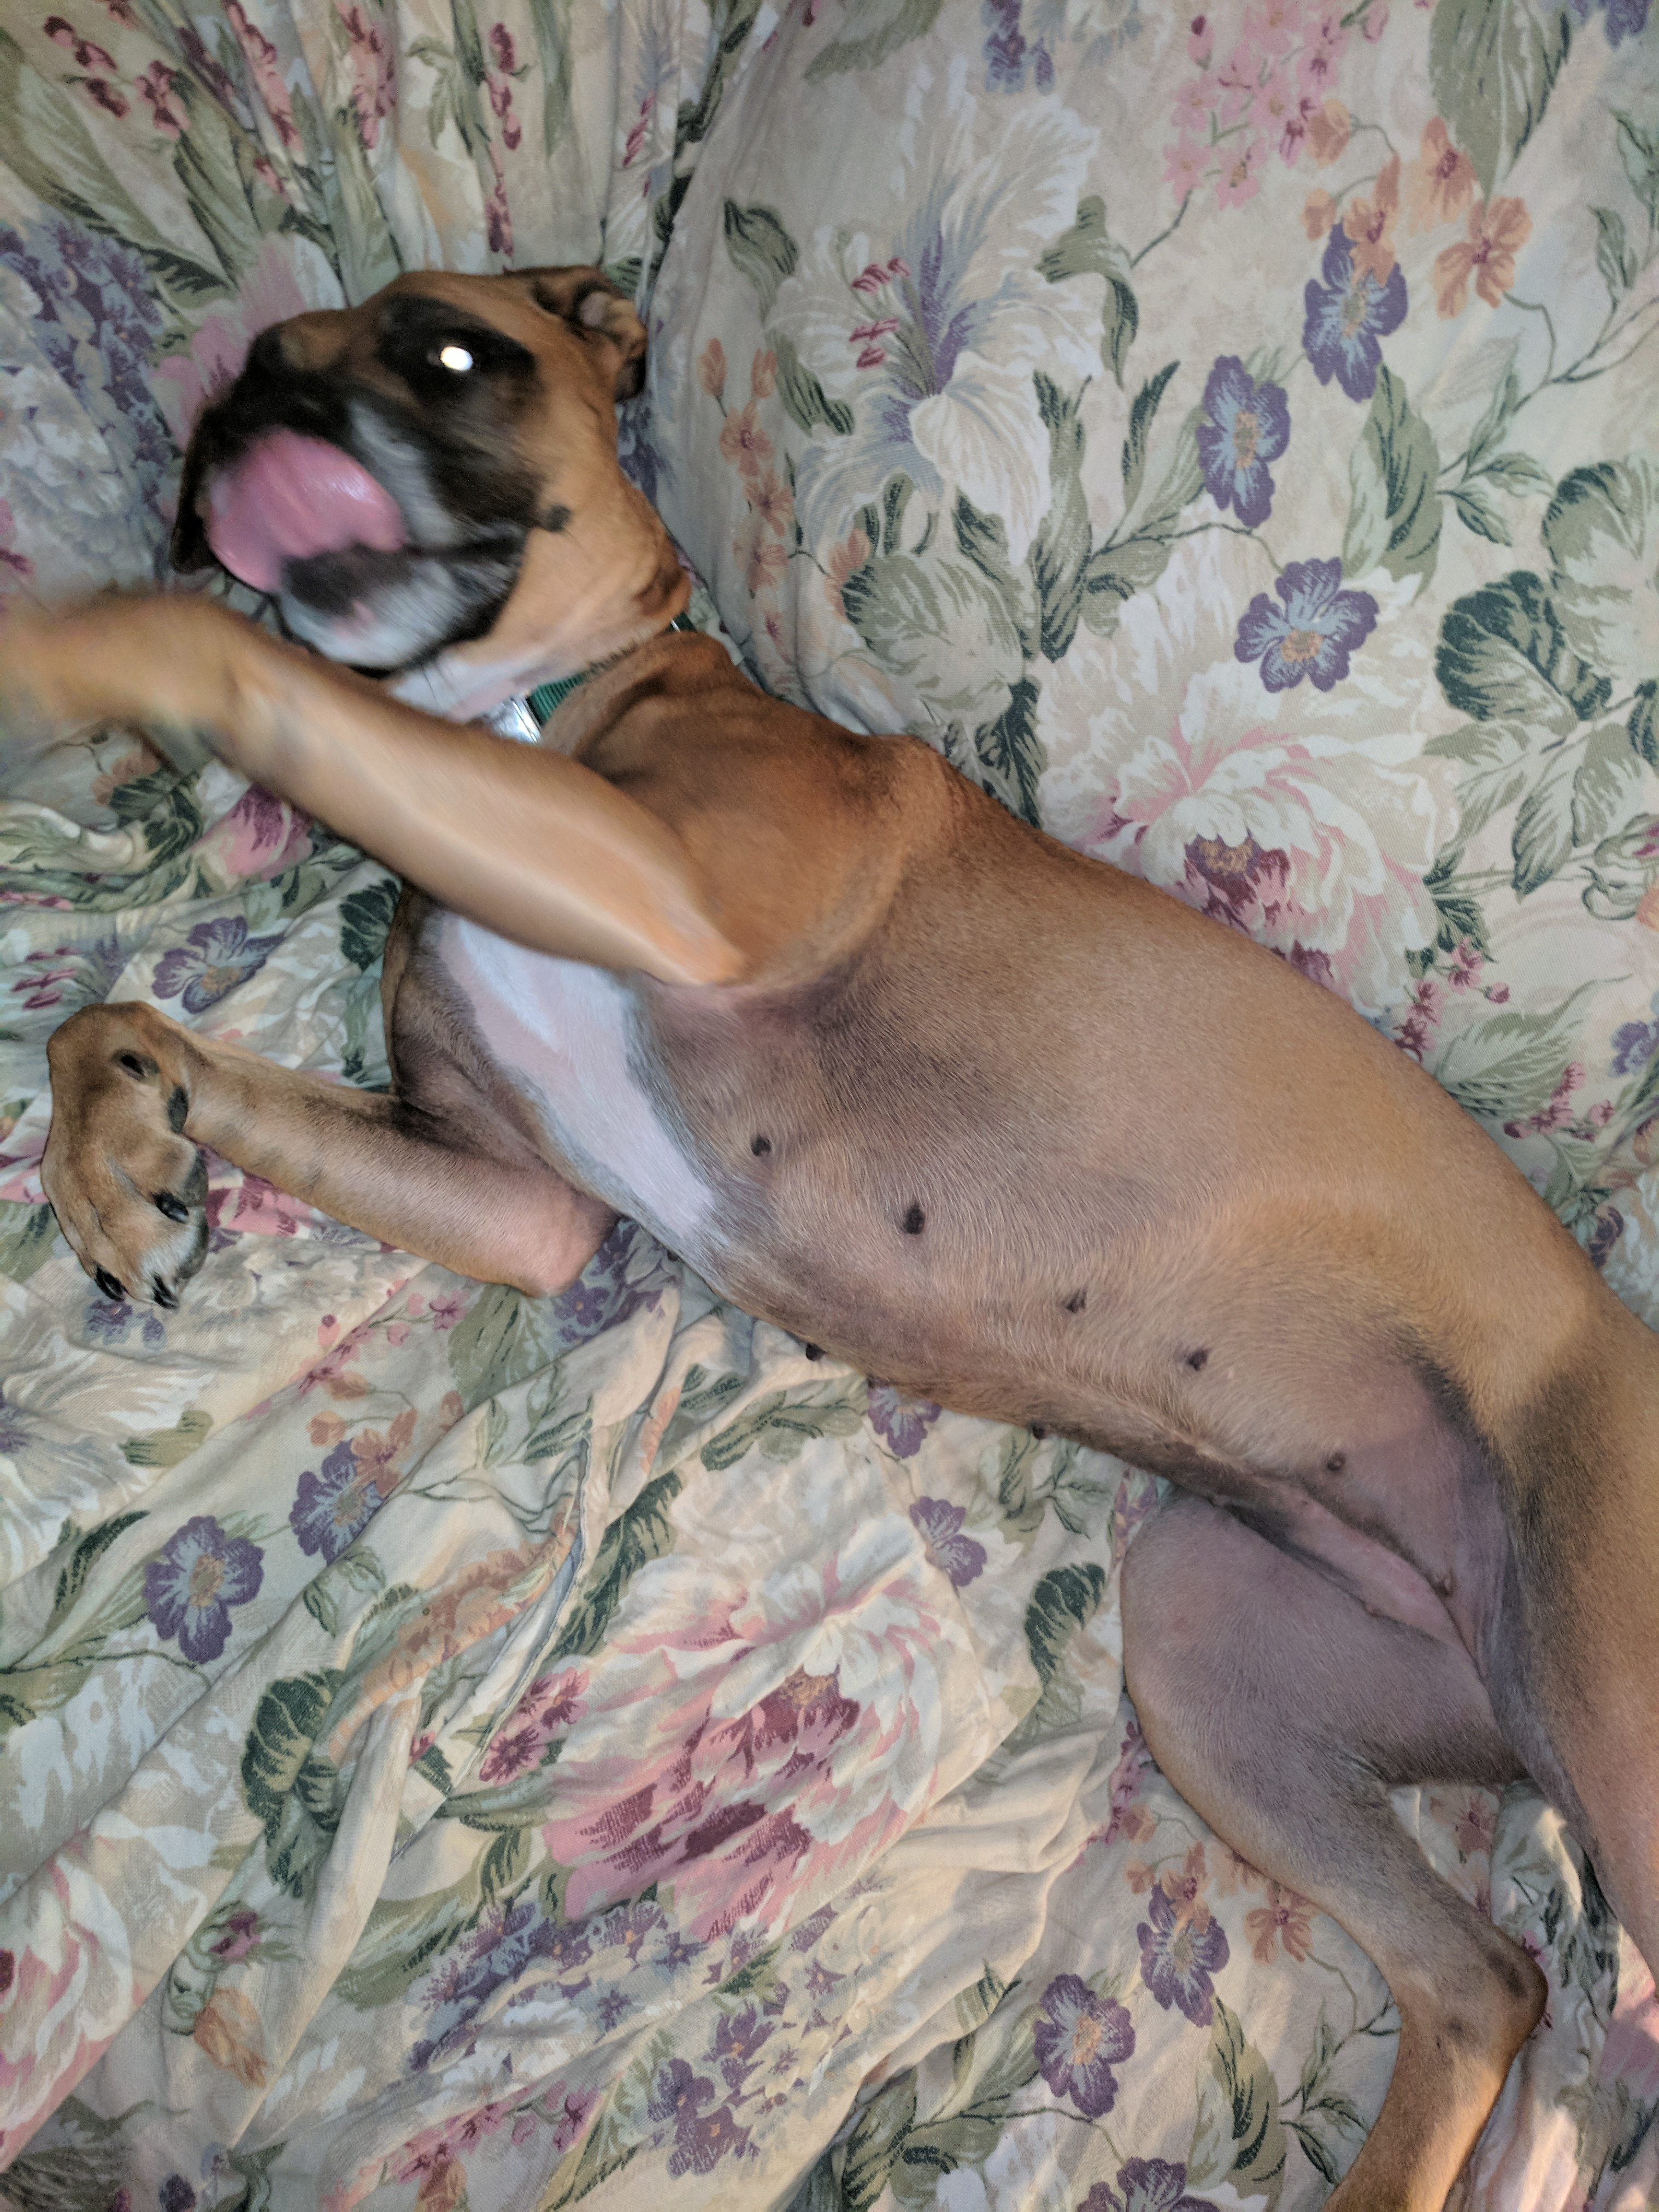
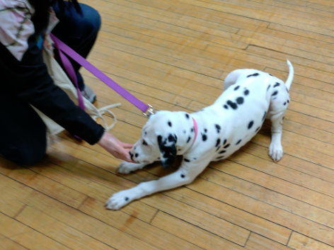
Tongue Flick
Appeasement and Conflicted
In order to keep yourself safe and prevent the dog from acquiring a bite history, learning to read canine body language is first on the list of priorities as a dog handler.
Canine Body Language
Notes:
Connie Talked about body language so not spending a lot of time here. As shelter workers, you’re looking for the precursor to a bite.
While tongue flicks are some of the easiest stress signals to miss because they happen so fast, appeasement behaviors and conflicted dog are often misunderstood When we see a dog cowering, showing it’s belly, or like the little Dal, she would walk toward me wagging her tail and as soon as I showed interest, she’d back up, shy away – even with her owner and show her teeth. My foster – Anna belly and tongue – she has never bitten anyone. Our instinct is to reassure them. We frequently see the fear, but not the danger.
Watch for the freeze - Trill and his potato chip - ½ second freeze if that Myself and one of the two handlers saw it and I got my leg out of the way just in time. You cannot be lax or overconfident around (potentially) aggressive dogs.

Slide 24
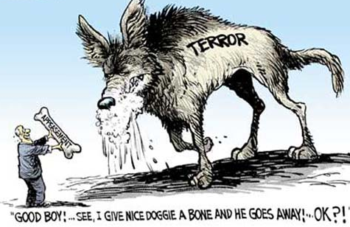
Notes:
Going back to our need to comfort – this is what your dog is seeing when they’re fearful

Slide 25

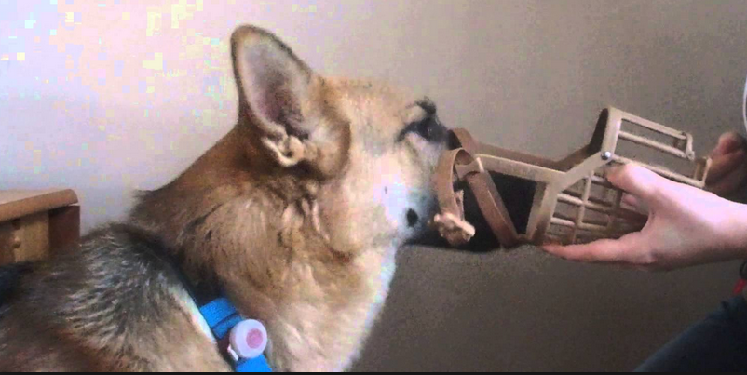
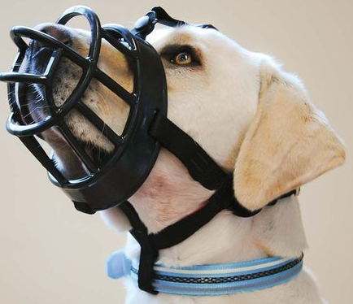
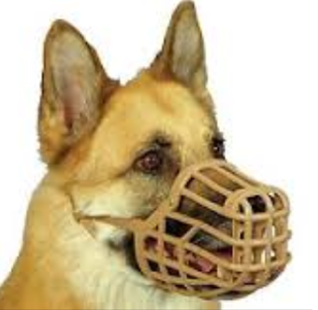

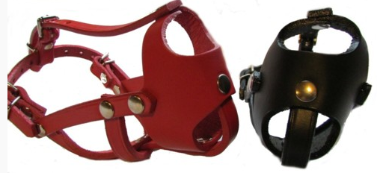
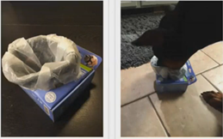

Muzzles
Two Recommended by Mike Shikashio
How to Train
Unable to Reach Mouth
Conventional Counter-Conditioning Method
Chirag Patel –Teaching A Dog to Wear A Muzzle - Youtube
Hands Free Method
https://www.kongcompany.com/recipes/
Baskerville
Morrco – custom made
Boston Terrier leather
(also have 10 sizes of plastic as opposed to 6)
Mixed canned food with liquid
Notes:
Baskerville hands down number1 comes in 6 sizes secure attaches above and below to collar boil to fit better – longer or press to make shorter to get treats to dog - things to use if still can’t reach
Morrco – IAABC M Shikashio – dog a bit harder to fit – 10 sizes and custom made
How To Train – from hand, Blue Cross UK Chirag Patel another one on youtube
Tricks – Baskerville Ultra dogs already dislike muzzle or you think may be too aroused to start with hands
– lined with wax paper put kibble in – dog learns to accept the feel of the muzzle
around his face 2 paper out and spray cheese or peanut butter on bottom –
now gets rubber sensation

Slide 26
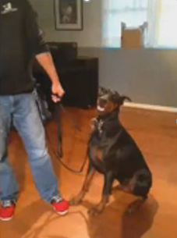
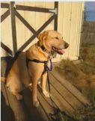
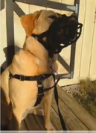
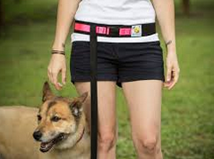
Two Points of Contact When Needed
Coupler attached to Coupler attached Waist Leash – handlers that
Harness and collar to harness and Baskerville Muzzle drop leash, play tug, training
(match dog size to handler)
Notes:
Michael Shikashio - waist lead and leash Girl in picture more for training.

Slide 27
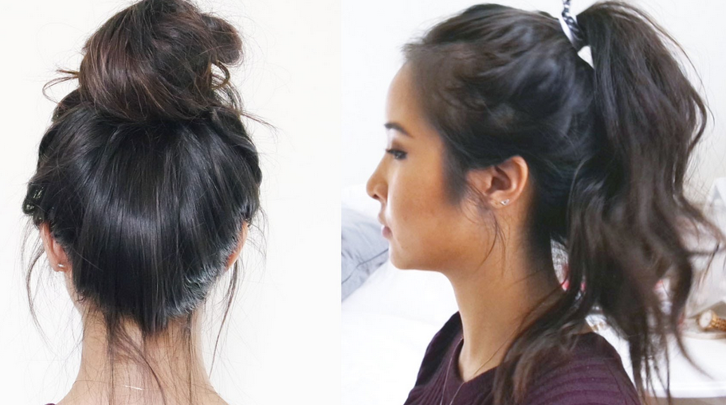

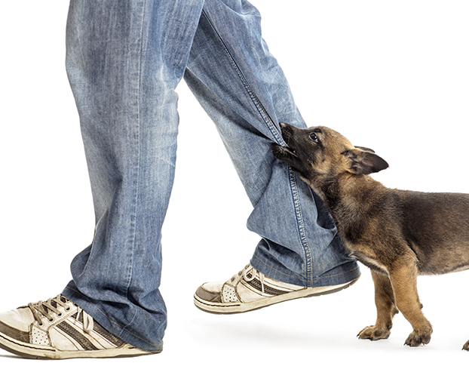
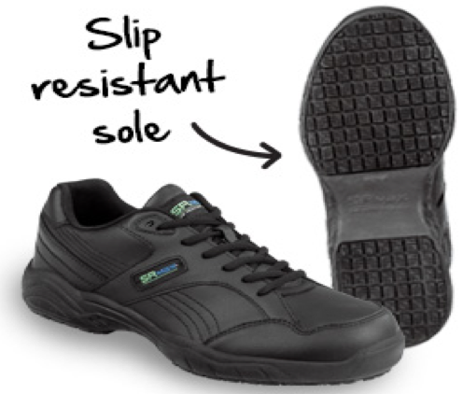

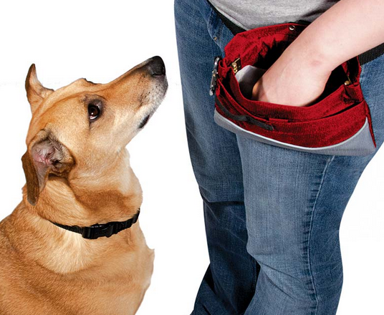
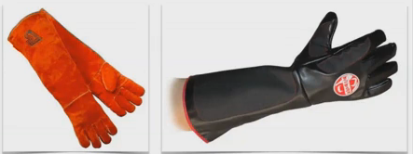
Dress for Safety
No Loose or
dangling jewelry
Long hair – tie back
No Loose clothing
Notes:
Going back to our need to comfort – this is what your dog is seeing when they’re fearful

Slide 28
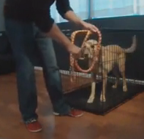
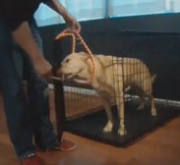
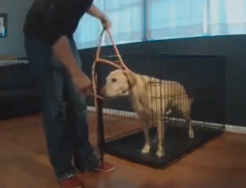
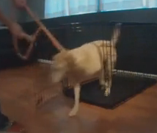
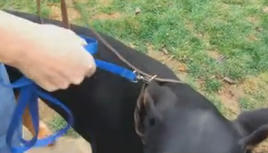
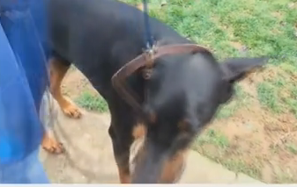
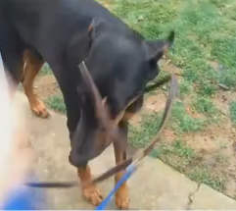
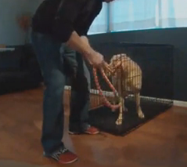
Getting Aggressive Dog In and Out of Kennel Using Slip Leash
Notes:
Be sure the “pull” end of the lead comes across the top, not bottom
From top it will release when dog isn’t pulling, from bottom could lock.
Open kennel, brace door with foot. Use long wooden spoon with peanut butter or spray cheese on end to lure dogs head through lead loop and, away you go.
To return, when dog is distracted clip a light weight different colored leash to the ring of the slip leash. Dog re-enters kennel, brace door and as dog turns, pull the slip lead loose with the other one and both through the door. (Practice this with calm dogs before you need to use it!)
Caution – you want the dog to learn to walk without pulling but beware, if the slip lead doesn’t have a stopper you’ll need to keep some tension on line to prevent from falling off dog’s head if he lowers it etc.

Slide 29
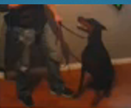
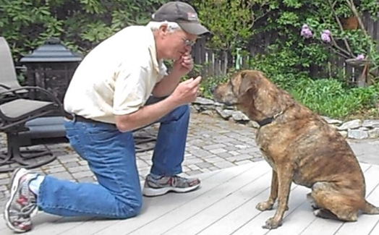
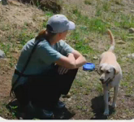
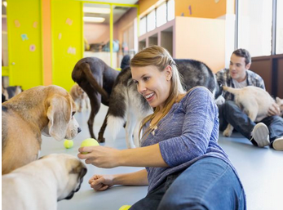
Positioning
Notes:
Body positioning
Don’t put yourself in a compromised situation when working with aggression or possible aggression.
Want to take dog’s comfort into consideration, but not imposing but also keep your safety as priority.
If you have a fearful dog, you may need to make yourself smaller but you can see here that Trish McMillan Loehr is in a position where she can move up quickly.

Slide 30
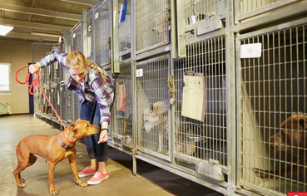
Be Aware of the Situation and Environment
Know the Dog you are working with if you DON’T KNOW THE DOG, ASSUME THE WORST until you know him better
DON’T PUT YOURSELF BETWEEN THE DOG AND A TRIGGER
If the Dog Re-directs, you are in the
field of fire
Short Leash in confined spaces
call Out when going around corners,
Through closed doors etc to avoid
Surprise meetings with other dogs / people

Slide 31
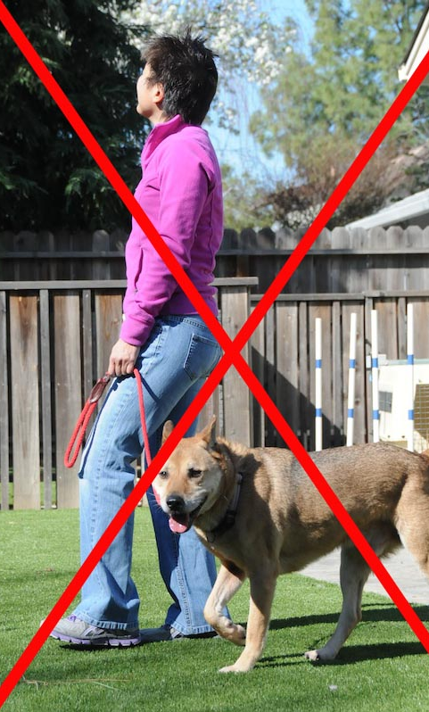
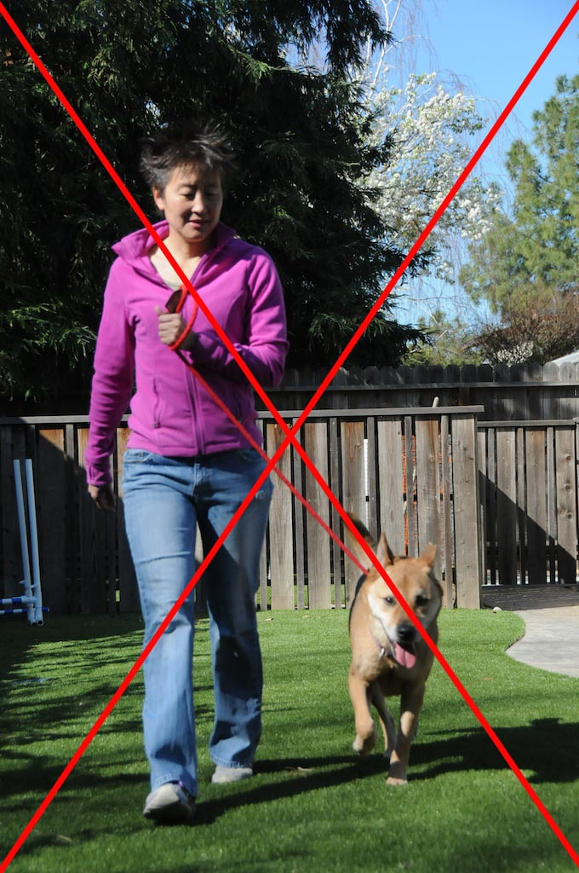
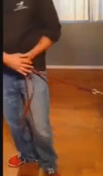
Mechanical Skills for Safety
Where is your center of gravity?

Slide 32
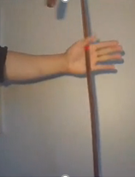
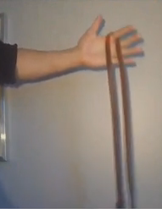
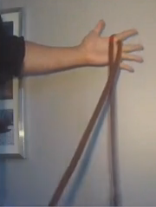
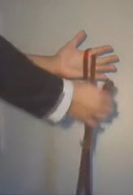
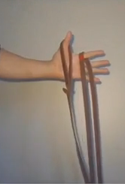

Mechanical Skills for Safety
Leash Lock
  Hold leash close to hips, right hand over left for maximum strength
Michael Shikashio - CompleteCanine.com

Slide 33



Mechanical Skills for Safety
Accordion leash hold – When Assessing a dog you may not want to be “locked” to it. Leather Leash is less likely to slip through your hands

Slide 34






Mechanical Skills for Safety
Accordion leash hold – When assessing a dog, you can use this leash hold and bring arm straight out in front of you, use both hands if needed, and can help prevent yourself from being bitten.

Slide 35
Mechanical Skills for Safety
Leash Grabbers
  Can be a pre-cursor to more aggressive behaviors, especially with bored shelter dogs
  Distract with a toy
  Use a cable or chain leash
  PVC pipe and tennis ball section over leash

Slide 36

Mechanical Skills for safety
If Dog escalates and you’re concerned for your safety:
Stay Quiet – screaming / yelling only adds to stimulation
Run leash around a tree or pole, something to keep dog away until you can get control or help
Get something between you and the dog
“feed” the leash to the dog
Dual handlers
If dog is aggressing towards other stay focused on the dog but walk in opposite direction

Slide 37
Breaking Up a Dog Fight
Have a plan, be prepared before a fight breaks out
  See the Play Group Handbook in the PupPartners ™ Shelter Package
Number of dogs to handler – ideally one to one
Check - who is the aggressor
Keep leashes dragging during intro

Slide 38
Breaking Up a Dog Fight
Tools for a fight kit
  Noise makers (food pans, air horn, pet correction
  Squirt bottles, hoses in dog yard
  Citronella spray – spray in front of dogs nose - unless not effective then into mouth
  Break Stick – you should know how to use this before the first time it’s needed
Other things to have on hand
  Folding chair, trash can or “Break Board” – something to put between the dogs
If you have to, pull dogs apart using their rear legs – grab where legs meet body, turn them and COMMIT NOTE: This should not be used for “grippers”

Slide 39
Breaking up a Dog Fight
The Nevers
  Never grab a collar
  Never hit, kick or punch – causing pain causes dog to grip harder
  Never get between dogs
  Never pick up a dog – makes that dog more interesting and – both of your hands are now occupied

Slide 40
Summary
Learn to read dog body language
Be aware of your situation and surroundings
Have the right equipment and training
Remain calm and quiet
Do not exceed your level of experience, it’s not safe for you or the dog

Slide 41


Continue Your Education

Slide 42

Low Stress Vet Care
Make vet visits fun and safer for everyone!

Slide 43
Why Use Low Stress Techniques
Safer for the animal- Stress causes a physiologic response.
Safer for the staff-Calm handlers help keep animals calm. Calm animals mean less chance of injury.
Increased adoptability

Slide 44
Start Before You Need It!
Build a foundation
Muzzle Training.
Targeting scary things
Meet vet staff without vet care
Work on handling every day
  Touching feet, face, hind end.
  Reward the handling!

Slide 45
Muzzle Training
Often the muzzle is more stressful than the exam or treatment being performed
Teaching a dog to tolerate a muzzle BEFORE stressful handling will make things easier for everyone.
Make it a game!
Have “caution” dogs already wearing a muzzle when entering exam rooms

Slide 46

Simza relaxed with a muzzle on

Slide 47
Manual Restraint
Remember, less is more.
When possible, use just your hands, not your arms or entire body.
Train staff to hold for vaccines. Animals will be more comfortable with someone they know well.
Stop immediately scruffing cats!

Slide 48

Photo from Vetstreet.com

Slide 49
Mechanical Restraint
Muzzles! Basket muzzles allow dogs to pant, drink, eat treats.
Towels-Especially for cats and small dogs
Cat bags- Personally, I hate them. If you can get the cat in the bag, you probably don’t need it.

Slide 50

Pic from ASPCApro

Slide 51
Chemical Restraint
Sometimes necessary for safety
Anti-anxiety meds can help “take the edge off” without actual sedation
Acepromazine used to be the go-to. Doesn’t actually decrease anxiety, just causes sedation.

Slide 52


Lunch and Networking

Slide 53

Canine Body Language - video

Slide 54

Dog Introductions - Video

Slide 55
Dog Introductions
Begin on leash
Walks together maintaining safe distance
Observe body language
Move to play yard when deemed safe
Follow playgroup protocols for moving to off leash

Slide 56

Playgroups- Video

Slide 57






PupPartners ™ Shelter Package

Slide 58
PupPartners ™
Comprehensive set of tools to assist in the set up of new shelters or improvement of existing shelters
  Important forms – intake, surrender etc.
  Behavior questionnaire for dogs
  Information questionnaire for potential adopters
  Objective color matching system
  ACCESS database template for data tracking
  Behavior modification protocols
  Behavior Modification and Training Academy program

Slide 59

Adopter Questionnaire

Slide 60

Dog Questionnaire

Slide 61

Color Matching System

Slide 62
ACCESS Database Template

Slide 63

Canned Reports

Slide 64

Common Behavior Protocols

Slide 65

Behavior Modification and Training Academy

Slide 66

PupPartners ™ S.P.I.R.I.T. Program
Shelter Pups & Inmate Rehabilitation & Integration

Slide 67

Enrichment

Slide 68
Importance of enrichment
Stress begins as soon as the animal is placed in the shelter and doesn’t completely end until the animal is adopted
Stress is a huge factor in the health of both animals and humans-How do you alleviate your stress? EX: Vacation, reading, relaxing, walking
Stressed animals are harder to adopt
Stressed animals show more aggression even if they were not aggressive when entering the shelter-
Stress results in placing an animal into a heightened survival mode and the Fight or Flight behaviors start to appear-
All living creatures have this instinct in them including humans.
If we didn’t have the fight of flight mode, we would die. Its that simple.
SIGNS OF STRESS SHOULD NOT BE IGNORED.. it affects both training and adoptability..

Slide 69
Causes of stress in shelters
Imagine this…you’ve spent the last 3 years, 8 years, 12 years, living with your family. Enjoying life. Happy. Then one day you go for a car ride and end up being forced into strangers hands, led into a 6’x10’ cage(if your lucky) where it is so deafening loud, cold, wet, and every dog around you acts like they want to kill you. Your confused. Scared. Shaking. And you wonder….how long will this last?

Slide 70
Stress in shelters (continued)
Scary environment
Separated from your family
Not sure how long you will be here
Loud
Damp
Barking dogs
People you don’t know
People you don’t know trying to touch you
Vet visit
Some days you don’t leave your run
No control over your environment

Slide 71
Signs of stress
Pacing
Spinning
Excessive jumping- In an attempt to control environment
Excessive barking- In an attempt to control environment
Panting-When not related to exercise or heat
Drooling-When not related to exercise or heat
Excessive drinking-
Increased aggression- In an attempt to control environment
Decreased activity-Depressed
Decreased appetite- Too stressed to eat when not due to illness
Shaking- When not due to illness or cold

Slide 72
Signs of stress (continued)
Animals exhibiting stress behaviors are most likely trying to control their environment because they feel confined and unable to do what is necessary for their needs and for their survival.

Slide 73
What we can do to help
With limited staff and resources shelters often have to be creative in finding ways to develop a strong enrichment program. We love junk!! Water bottles can serve as make shift food dispensing toys, carpets on the walls as sound insulators, music a few hours of the day with lights off for down time, and using old sheets and blankets to make new tug toys are simple inexpensive ways to work with what you have available.

Slide 74
Enrichment ideas
Volunteers and staff – We love them!!!
Develop an easy enrichment program that is done on a daily basis. More than just a walk.
Train!! Using R+ to train dogs you challenge their minds and help keep them from deteriorating
Quiet time. Play music (Through a dogs ears) for an hour and turn off the lights.
Stuffed/frozen kongs
Food dispensing toys- working for their food ignites their problem solving skills and keeps them from deteriorating

Slide 75
More enrichment ideas!
Give each animal something good when they return to their runs so returning doesn’t mean you leave and the fun is over. Make their runs a positive place to be.
Sit in’s-siting in with a dog or cat just spending time with them even if it’s only 5minutes can mean the difference between a good day and a bad day. A lot of the time we spend walking or training but we never spend time petting and/or just allowing the dog to sit next to you.
Think about your own pets, what do they get on a day to day basis that shelter dogs do not get? Your time and attention is one thing that most dogs living in shelter rarely experience enough of.

Slide 76



Enrichment schedules

Slide 77


Enrichment rocks!

Slide 78
Questions?
Thank you for joining us today.
We look forward to working with you in the future!

