Slide 1
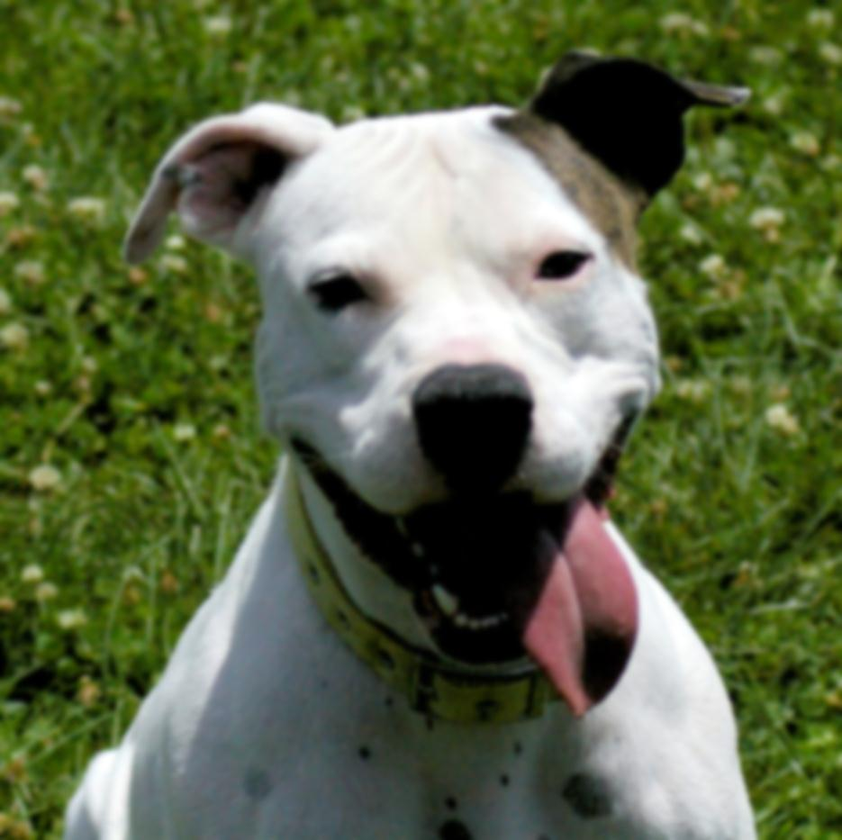
Making Shelter Life Positive
Presented by
Constance Dwyer, CABC; Sara Hamburger, BMTA

Slide 2
Copyright Notice
WARNING
All rights reserved. No part of the course materials used in the instruction of this course may be reproduced in any form or by any
electronic or mechanical means, including the use
of information storage and retrieval systems,
without written approval from the copyright owner.
©2013-2017 Constance Dwyer
Training4k9s.com

Slide 3
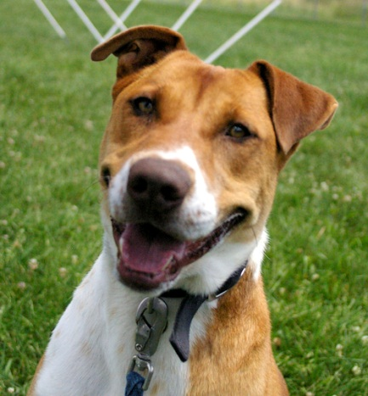
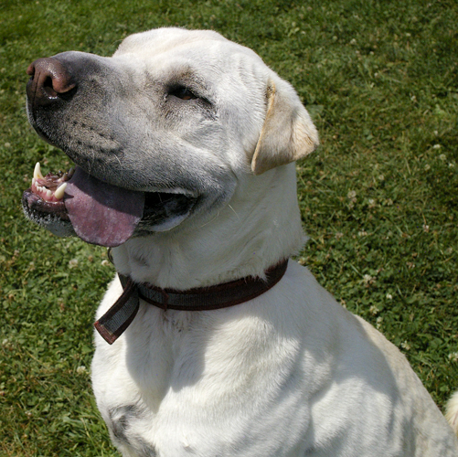
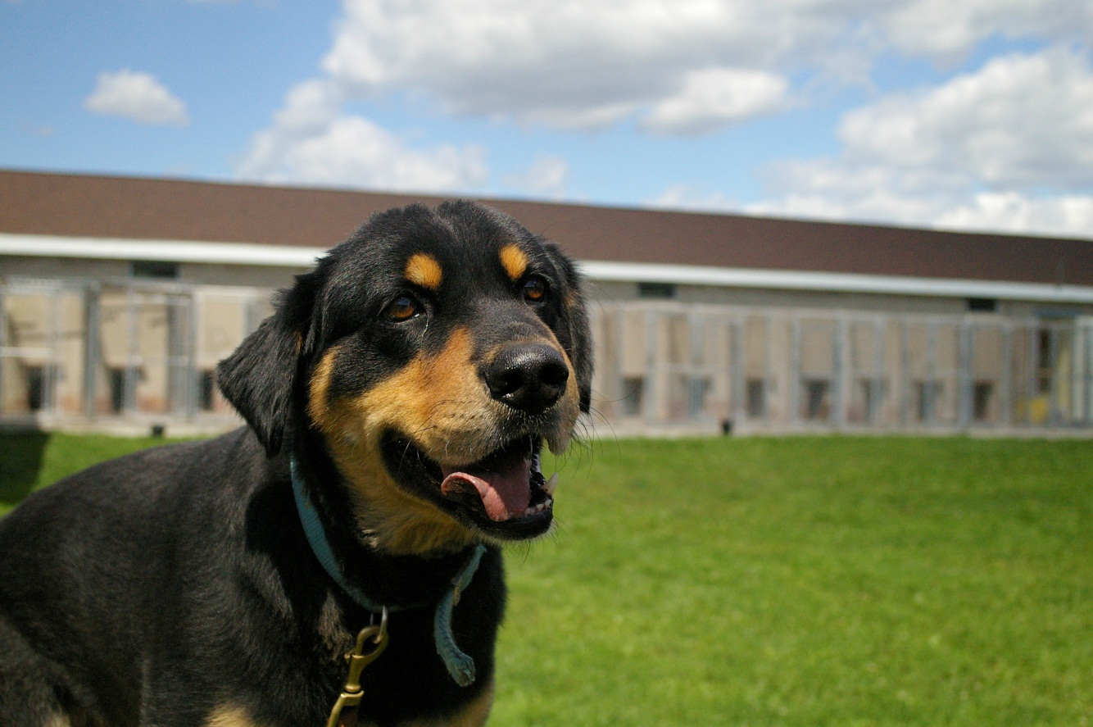
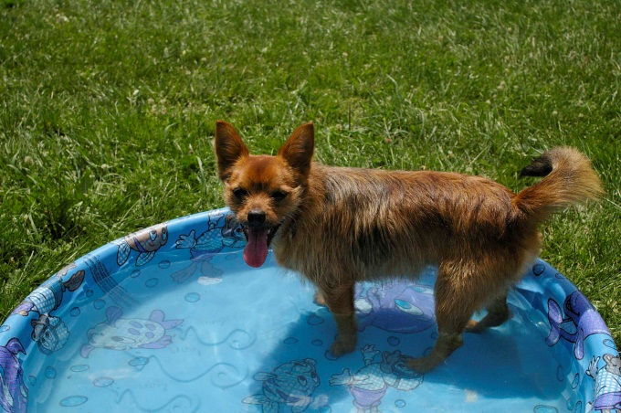
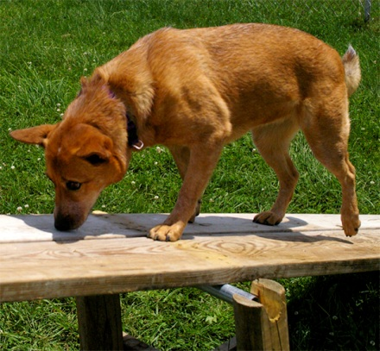
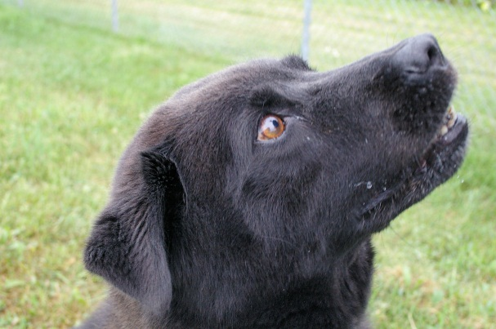
WELCOME!

Slide 4

Safety Message and Intros

Slide 5

Introductions
Constance Dwyer, CABC
  IAABC Certified Animal Behavior Consultant
  19+ years behavior and training experience
  Animal Behavior College mentor
  AKC Canine Good Citizen Evaluator
  Animal Care Sanctuary Behavior Consultant
  Love on a Leash Therapy Dog Evaluator
  4H dog and horse club leader
  Lean Six Sigma Black Belt

Slide 6
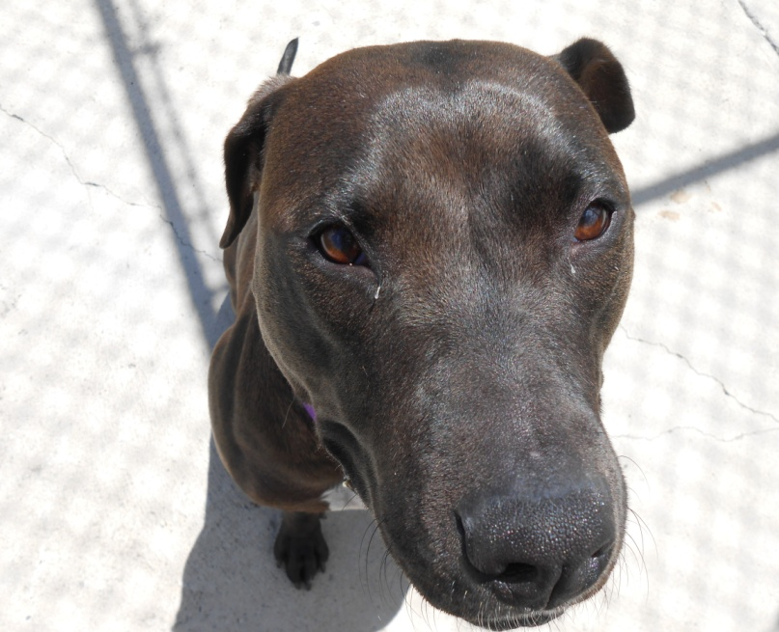
Introductions
Sara Hamburger, BMTA
    BMTA Training and Behavior Associate
    ACS Director of Enrichment and Behavior
    5 years experience in shelter behavior modification
    4 years experience in behavior consultation
    Freelance Artist!

Slide 7
Seminar Agenda
9:30 am – 10:00 am Arrival and Breakfast
10:00 am – 10:15 am Introductions and Overview of day
10:15 am – 10:45 am Learning Quadrant – Lecture
10:45 am – 11:15 am Training Game – Hands-on learning
11:15 am – 11:30 am Body Language
11:30 am – 12:00 pm Break/Scenarios
12:00 am – 12:30 am Lunch
12:30 pm – 12:45 pm Safety with Dogs
12:45 pm – 1:00 pm Pup Partners ™ Shelter Package/SPIRIT
1:00 pm – 3:00 pm Hands On with Dogs

Slide 8
Learning Theory

Slide 9
Reinforcements
Positive
  involves the addition of a stimulus following a behavior that makes it more likely that the behavior will occur again in the future.
Negative
  involves strengthening a behavior through the removal of an aversive stimulus.
+R
-R

Slide 10
Reinforcements - examples
Positive
  Real life examples
    Treats
    Praise
    Play
    ???
Negative
  Real life examples
    Ear pinching
    Loose leash walking
    ???

Slide 11
Punishments
Positive
  involves the addition of an aversive stimulus following a behavior that makes it more likely that the behavior will decrease/weaken in the future.
Negative
  involves the removal of a desirable stimulus following a behavior that makes it more likely that the behavior will decrease/weaken in the future.
+P
-P

Slide 12
Punishments - examples
Positive
  Real life examples
    Yelling at the dog
    Collar “correction”
    Stepping on their toes
    Kneeing in the chest
    ???
Negative
  Real life examples
    Crate time out
    Turning your back
    Changing direction
    ???

Slide 13
Learning Quadrant Exercise
+R
Positive Reinforcement
-R
Negative Reinforcement
+P
Positive
Punishment
-P
Negative Punishment
Decreases Behavior Increases Behavior

Slide 14
Operant Conditioning
Type of learning in which an individual's behavior is modified by its consequences.
Operant conditioning is a term that was coined by B.F.Skinner. Operant conditioning is distinguished from classical conditioning in that operant conditioning deals with the modification of voluntary or operant behavior.

Slide 15
Classical Conditioning
Marker or Clicker Training
previously neutral stimulus (the click sound) is known as a Conditioned Stimulus that provokes a Conditioned Response (anticipation of food or something else the dog wants – toys, play).
Discovered by Psychologist Ivan Pavlov
– Pavlov’s Dogs

Slide 16
Why do we care?
As instructors and trainers we want to strengthen safe, positive associations to build trust, companionship and life long partnerships between humans and dogs.
Who are your friends and loved ones?
What relationships do you have with them?
What are they built on?

Slide 17
Hands On Learning
+R Behavior Shaping Game
  1person is a trainer
  1 person is a trainee
  No verbal directions
  Human behaviors
  Use clicker (marker) to communicate

Slide 18
Hands On Learning
+R Behavior Shaping with Shelter Dogs
  Break up into smaller groups
  Work with FLSPCA staff and dogs
  Shape basic behaviors – sit, down etc.
  Loose leash walking instruction

Slide 19
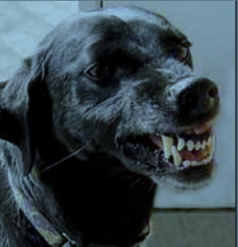
Dog Bite Safety
Handling Aggressive Dogs

Slide 20
Breaking Up a Dog Fight
Have a plan, be prepared before a fight breaks out
  See the Play Group Handbook in the PupPartners ™ Shelter Package
Number of dogs to handler – ideally one to one
Check - who is the aggressor
Keep leashes dragging during intro

Slide 21
Breaking Up a Dog Fight
Tools for a fight kit
  Noise makers (food pans, air horn, pet correction
  Squirt bottles, hoses in dog yard
  Citronella spray – spray in front of dogs nose - unless not effective then into mouth
  Break Stick – you should know how to use this before the first time it’s needed
Other things to have on hand
  Folding chair, trash can or “Break Board” – something to put between the dogs
If you have to, pull dogs apart using their rear legs – grab where legs meet body, turn them and COMMIT NOTE: This should not be used for “grippers”

Slide 22
Breaking up a Dog Fight
The Nevers
  Never grab a collar
  Never hit, kick or punch – causing pain causes dog to grip harder
  Never get between dogs
  Never pick up a dog – makes that dog more interesting and – both of your hands are now occupied

Slide 23
Summary
Learn to read dog body language
Be aware of your situation and surroundings
Have the right equipment and training
Remain calm and quiet
Do not exceed your level of experience, it’s not safe for you or the dog

Slide 24
Start Before You Need It!
Build a foundation
Muzzle Training.
Targeting scary things
Meet vet staff without vet care
Work on handling every day
  Touching feet, face, hind end.
  Reward the handling!

Slide 25
Muzzle Training
Often the muzzle is more stressful than the exam or treatment being performed
Teaching a dog to tolerate a muzzle BEFORE stressful handling will make things easier for everyone.
Make it a game!
Have “caution” dogs already wearing a muzzle when entering exam rooms

Slide 26
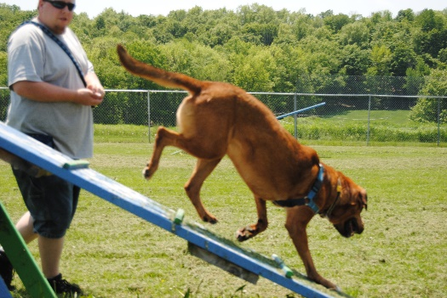
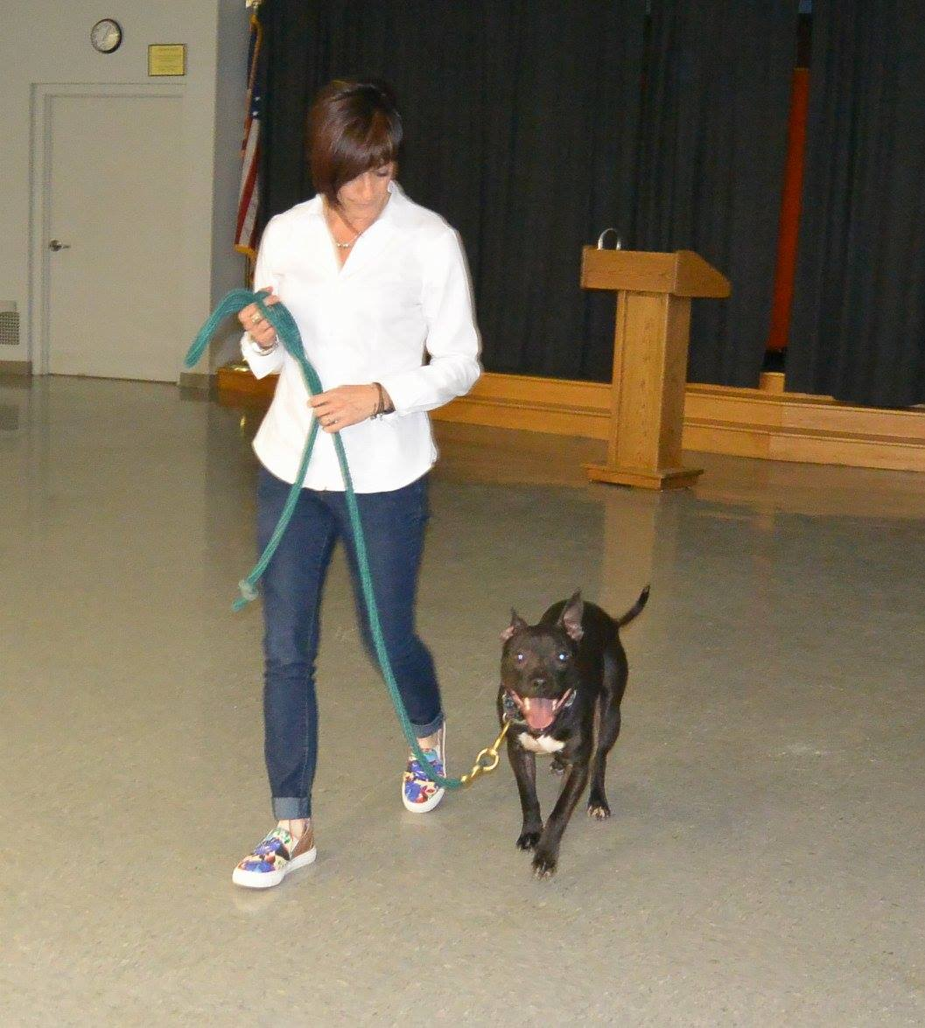
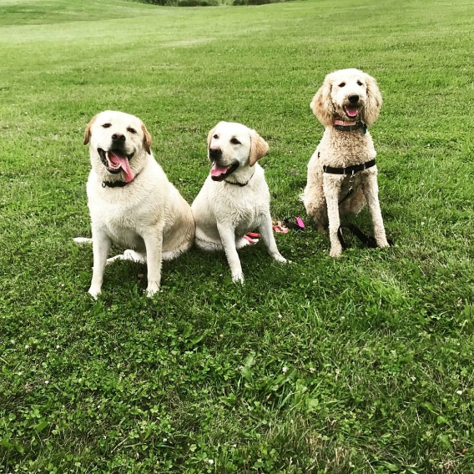
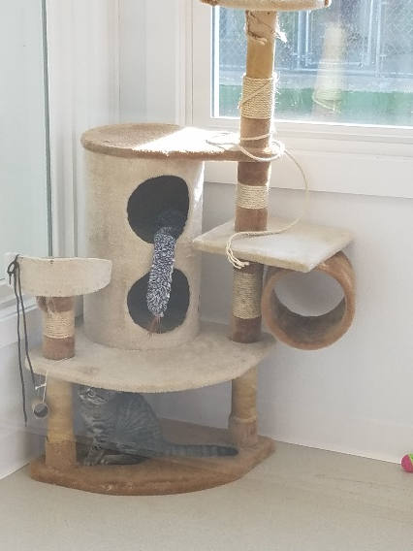
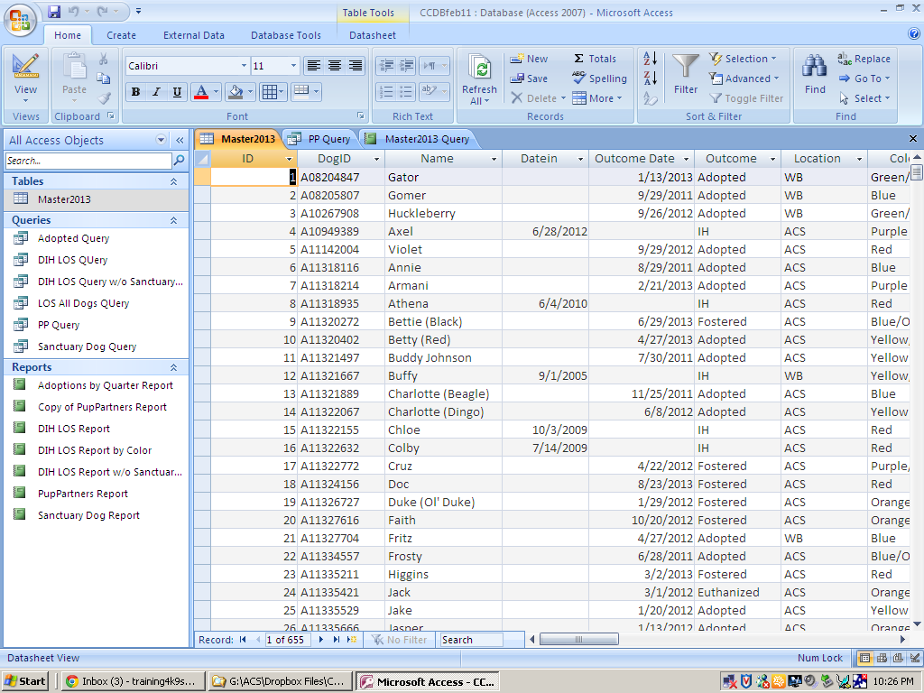
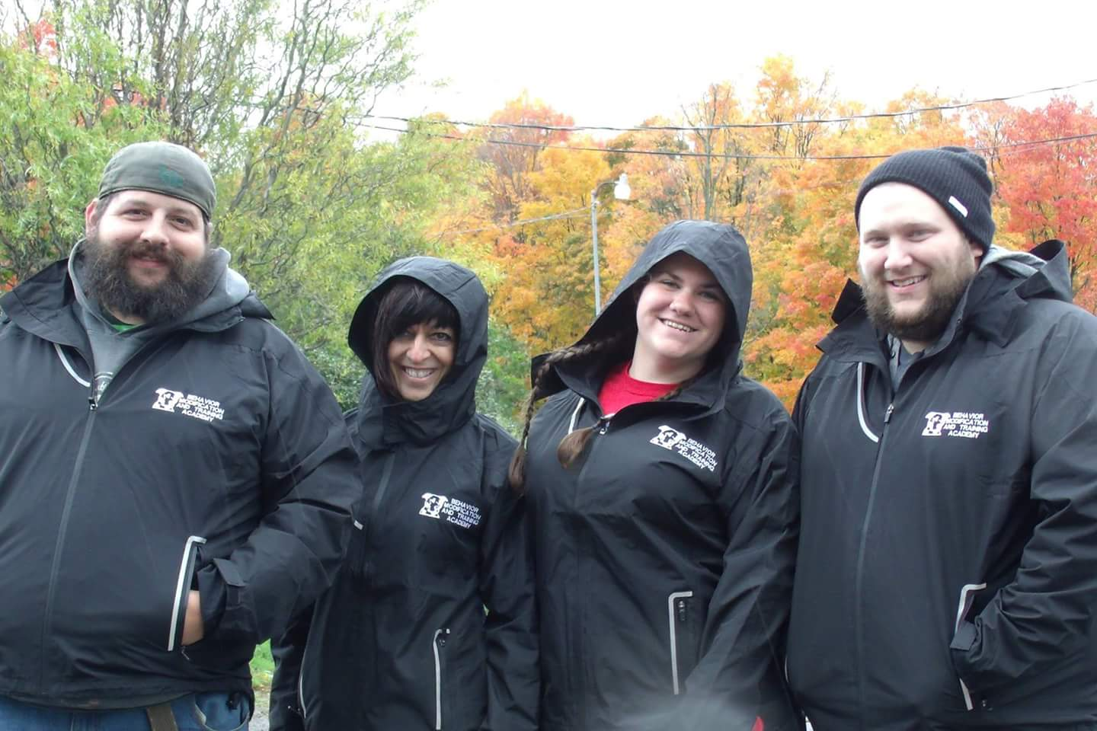
PupPartners ™ Shelter Package

Slide 27
PupPartners ™
Comprehensive set of tools to assist in the set up of new shelters or improvement of existing shelters
  Important forms – intake, surrender etc.
  Behavior questionnaire for dogs
  Information questionnaire for potential adopters
  Objective color matching system
  ACCESS database template for data tracking
  Behavior modification protocols
  Behavior Modification and Training Academy program

Slide 28
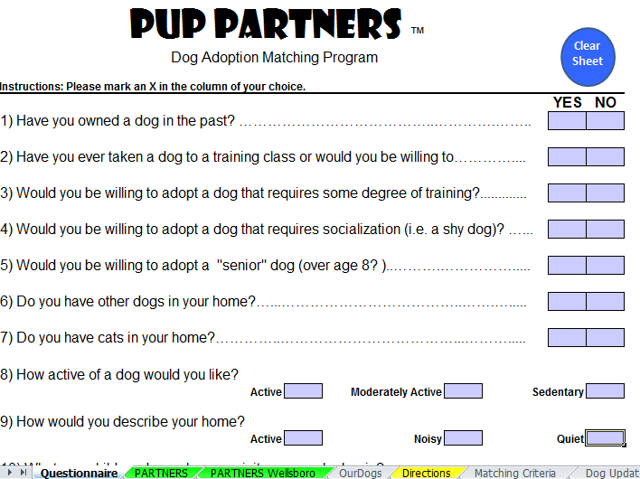
Adopter Questionnaire

Slide 29
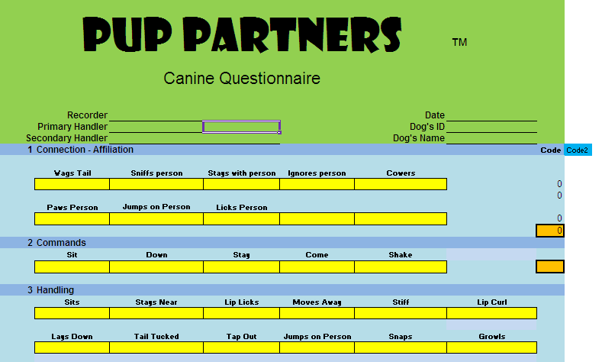
Dog Questionnaire

Slide 30
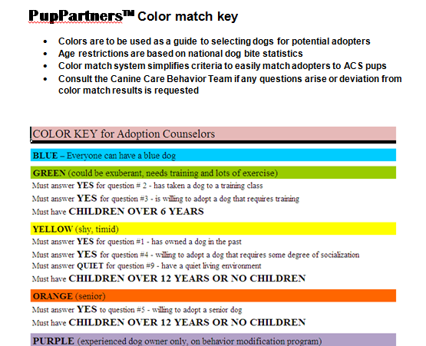
Color Matching System

Slide 31
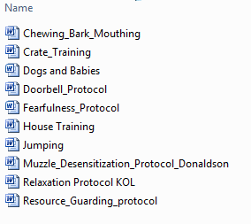
Common Behavior Protocols

Slide 32
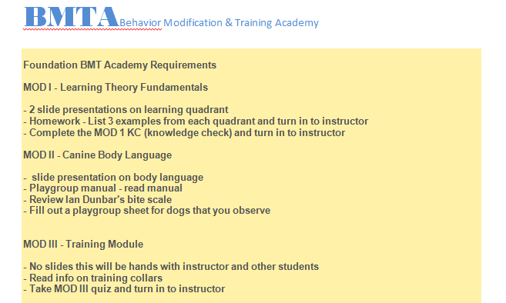
Behavior Modification and Training Academy

Slide 33

PupPartners ™ S.P.I.R.I.T. Program
Shelter Pups & Inmate Rehabilitation & Integration

Slide 34
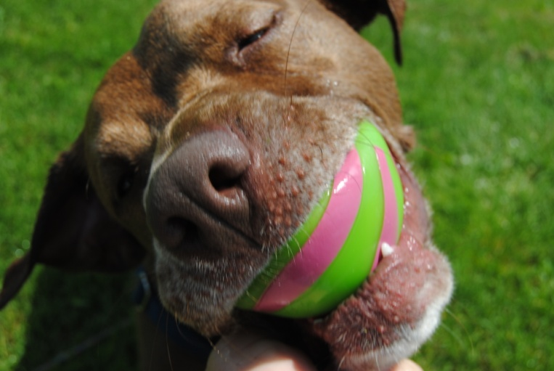
Enrichment

Slide 35
Importance of enrichment
Stress begins as soon as the animal is placed in the shelter and doesn’t completely end until the animal is adopted
Stress is a huge factor in the health of both animals and humans-How do you alleviate your stress? EX: Vacation, reading, relaxing, walking
Stressed animals are harder to adopt
Stressed animals show more aggression even if they were not aggressive when entering the shelter-
Stress results in placing an animal into a heightened survival mode and the Fight or Flight behaviors start to appear-
All living creatures have this instinct in them including humans.
If we didn’t have the fight of flight mode, we would die. Its that simple.
SIGNS OF STRESS SHOULD NOT BE IGNORED.. it affects both training and adoptability..

Slide 36
Causes of stress in shelters
Imagine this…you’ve spent the last 3 years, 8 years, 12 years, living with your family. Enjoying life. Happy. Then one day you go for a car ride and end up being forced into strangers hands, led into a 6’x10’ cage(if your lucky) where it is so deafening loud, cold, wet, and every dog around you acts like they want to kill you. Your confused. Scared. Shaking. And you wonder….how long will this last?

Slide 37
Stress in shelters (continued)
Scary environment
Separated from your family
Not sure how long you will be here
Loud
Damp
Barking dogs
People you don’t know
People you don’t know trying to touch you
Vet visit
Some days you don’t leave your run
No control over your environment

Slide 38
Signs of stress
Pacing
Spinning
Excessive jumping- In an attempt to control environment
Excessive barking- In an attempt to control environment
Panting-When not related to exercise or heat
Drooling-When not related to exercise or heat
Excessive drinking-
Increased aggression- In an attempt to control environment
Decreased activity-Depressed
Decreased appetite- Too stressed to eat when not due to illness
Shaking- When not due to illness or cold

Slide 39
Signs of stress (continued)
Animals exhibiting stress behaviors are most likely trying to control their environment because they feel confined and unable to do what is necessary for their needs and for their survival.

Slide 40
What we can do to help
With limited staff and resources shelters often have to be creative in finding ways to develop a strong enrichment program. We love junk!! Water bottles can serve as make shift food dispensing toys, carpets on the walls as sound insulators, music a few hours of the day with lights off for down time, and using old sheets and blankets to make new tug toys are simple inexpensive ways to work with what you have available.

Slide 41
Enrichment ideas
Volunteers and staff – We love them!!!
Develop an easy enrichment program that is done on a daily basis. More than just a walk.
Train!! Using R+ to train dogs you challenge their minds and help keep them from deteriorating
Quiet time. Play music (Through a dogs ears) for an hour and turn off the lights.
Stuffed/frozen kongs
Food dispensing toys- working for their food ignites their problem solving skills and keeps them from deteriorating

Slide 42
More enrichment ideas!
Give each animal something good when they return to their runs so returning doesn’t mean you leave and the fun is over. Make their runs a positive place to be.
Sit in’s-siting in with a dog or cat just spending time with them even if it’s only 5minutes can mean the difference between a good day and a bad day. A lot of the time we spend walking or training but we never spend time petting and/or just allowing the dog to sit next to you.
Think about your own pets, what do they get on a day to day basis that shelter dogs do not get? Your time and attention is one thing that most dogs living in shelter rarely experience enough of.

Slide 43
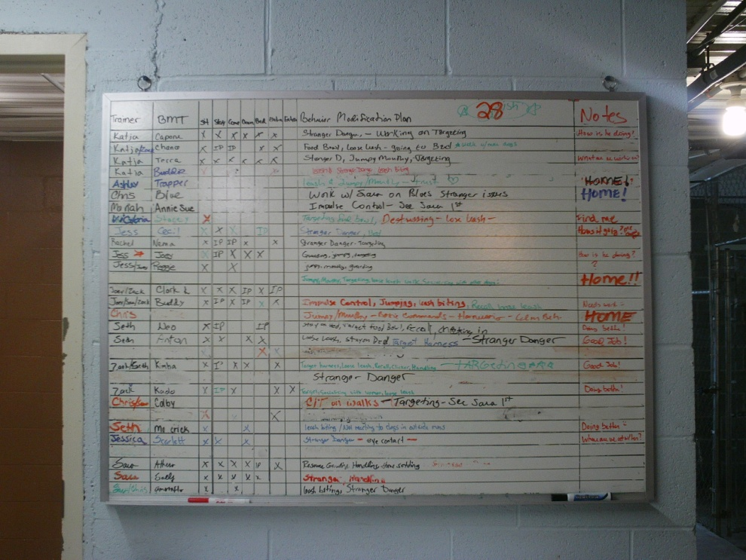
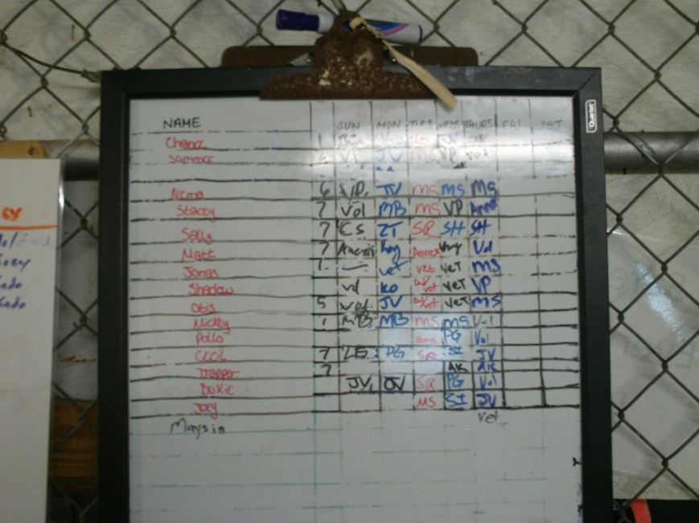
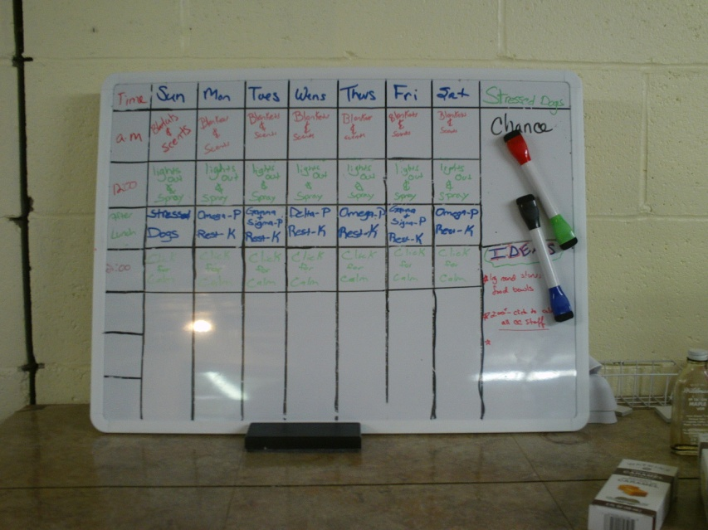
Enrichment schedules

Slide 44
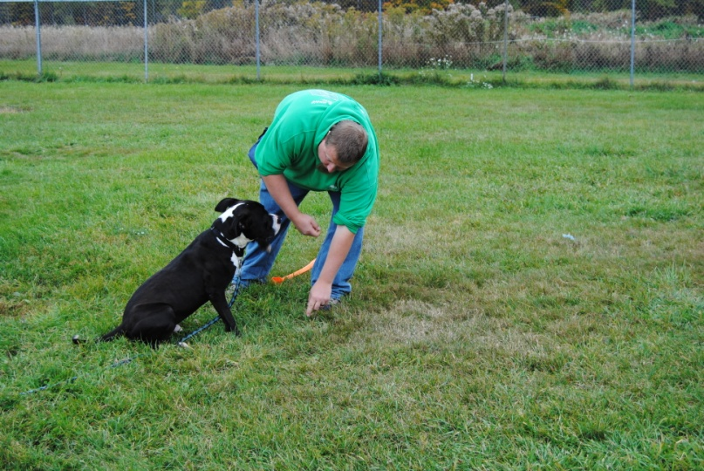
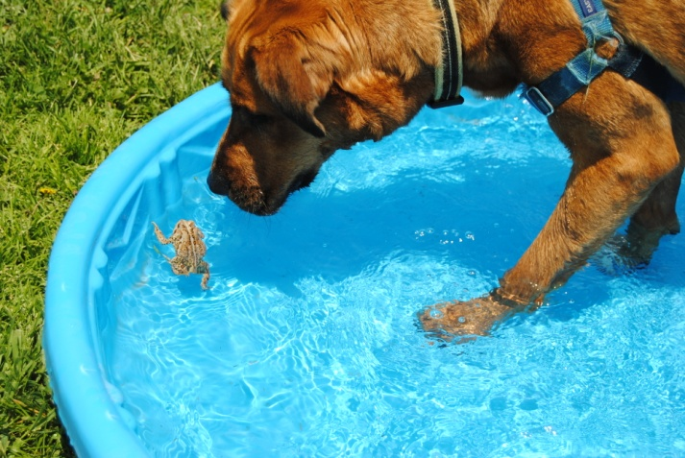
Enrichment rocks!

Slide 45
Questions?
Thank you for joining us today.
We look forward to working with you in the future!

